Slide 1
From Open Access To Open Science
Dr Paul Ayris
Pro-Vice-Provost (UCL Library Services)
Co-Chair, LERU community of Chief Information Officers (League of European Research Universities)
Adviser to the LIBER Board (Association of European Research Libraries)
Chair, Jisc Content Strategy Group
e-mail: p.ayris@ucl.ac.uk

Slide 2
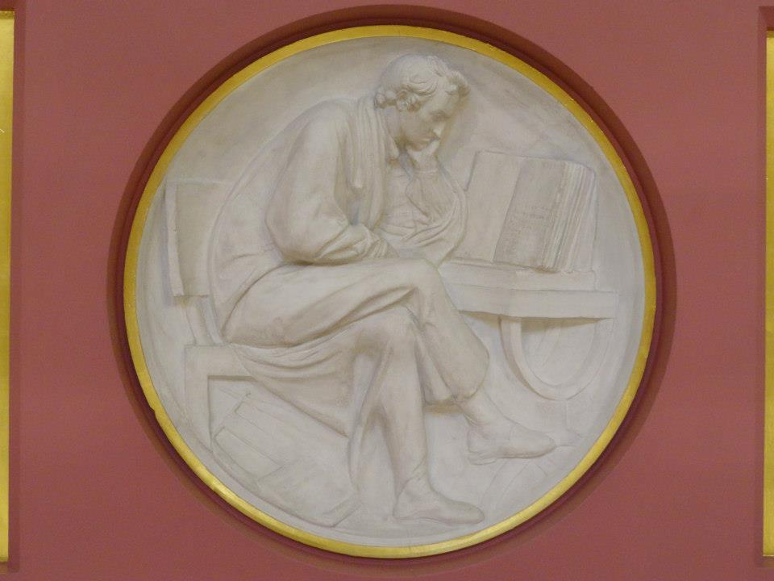
Content
Open Access
Open Science – What is it?
European Commission’s 8 pillars of Open Science
Taking Action
Conclusions?
Plaster Relief by John Flaxman,
Flaxman Gallery, UCL

Slide 3
Content
Open Access
Open Science – What is it?
European Commission’s 8 pillars of Open Science
Taking Action
Conclusions?
Plaster Relief by John Flaxman,
Flaxman Gallery, UCL

Slide 4
Open Access REF compliance in UCL (April 16-March 18)
Faculty | No of Papers Accepted | No of Compliant Papers | % Compliant Jan 18 | % Compliant Mar 18
Life Sciences | 1,581 | 1,369 | 86% | 87%
Arts & Humanities | 267 | 218 | 77% | 82%
Institute of Education | 794 | 639 | 83% | 80%
Laws | 168 | 135 | 78% | 80%
Brain Sciences | 3,859 | 3,071 | 79% | 80%
Maths & Physical Sciences | 2,651 | 2,074 | 77% | 78%
Social & Historical Sciences | 796 | 619 | 76% | 78%
Population Health Sciences | 4,181 | 3,226 | 75% | 77%
Engineering Science | 2,274 | 1,751 | 76% | 77%
Medical Sciences | 2,498 | 1,918 | 75% | 77%
SSEES | 70 | 52 | 66% | 74%
Built Environment | 594 | 428 | 75% | 72%
Compliant means that full-text was deposited within 3 months of first online publication as required by REF policy, or that an exception applies)

Slide 5
Content
Open Access
Open Science – What is it?
European Commission’s 8 pillars of Open Science
Taking Action
Conclusions?
Plaster Relief by John Flaxman,
Flaxman Gallery, UCL

Slide 6
What is Open Science?
Open Science is the movement to make scientific research, data and dissemination accessible at all levels of an enquiring society – FOSTER project
Open Scholarship a better title?

Slide 8
Content
Open Access
Open Science – What is it?
European Commission’s 8 pillars of Open Science
Taking Action
Conclusions?
Plaster Relief by John Flaxman,
Flaxman Gallery, UCL

Slide 9
Open Science is a strong commitment from European policy makers
Amsterdam Call for Action (2016) during Dutch Presidency
Commission’s Open Science Policy Platform
LERU responding in May 2018

Slide 10
Future of Scholarly Communication
EOSC (European Open Science Cloud)
FAIR Data
Skills
Research Integrity
Rewards
Altmetrics
Citizen Science

Slide 11
Future of Scholarly Communication
EOSC (European Open Science Cloud)
FAIR Data
Skills
Research Integrity
Rewards
Altmetrics
Citizen Science

Slide 12
European Open Science Cloud
EU High Level Expert Group Report
Launched on 11 October 2016
Issues considered:
Infrastructures
Skills development
Reward and Recognition
Roles and responsibilities
Governance & Standards
Funding opportunities
Available here
Notes:
Dr Ayris was a member of the EU’s High Level Expert Group on the European Open Science Cloud which issued its Report and Recommendations in October 2016. The Group, led by Professor Barend Mons, considered a whole range of issues:
Infrastructures
Skills development
Reward and Recognition
Roles and responsibilities
Governance & Standards
Funding opportunities

Slide 13
EOSC Declaration
33 goals for engagement in RDM
Data Culture
& FAIR Data
Services & Architecture
Governance & Funding
Open by default
Skills development
FAIR principles
Data Management Plans
Engagement with researchers
EOSC is an infrastructure commons
EOSC to use existing high spec. 3services
HPC to be developed in tandem
Strong Governance model, but flexible
3 levels of membership – institutional, operational, advisory

Slide 14
Content
Open Access
Open Science – What is it?
European Commission’s 8 pillars of Open Science
Taking Action
Conclusions?
Plaster Relief by John Flaxman,
Flaxman Gallery, UCL

Slide 15
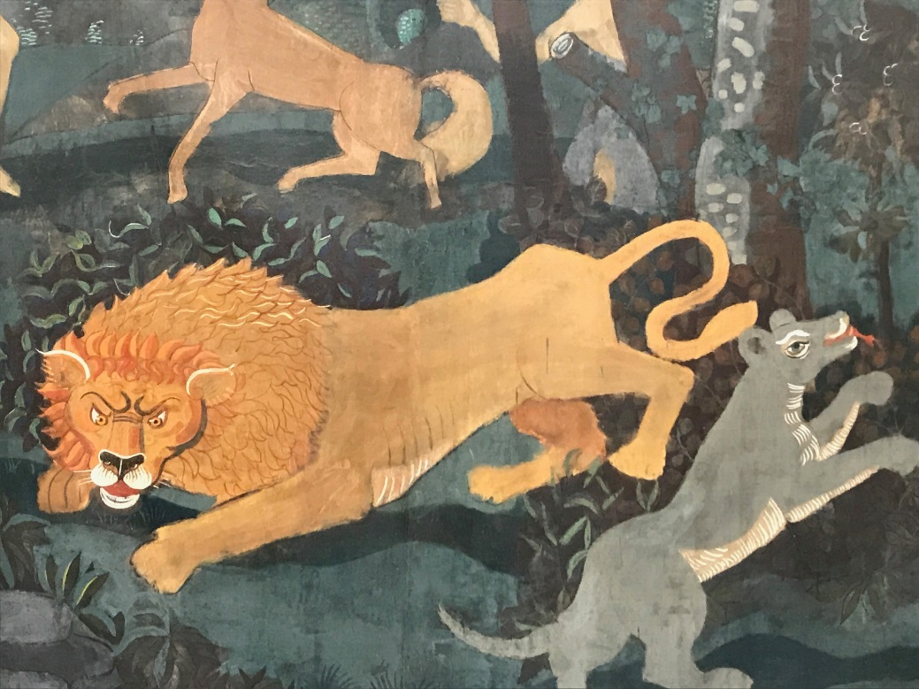
Leadership: Issues
Universities should be leaders, not followers
University should have a Vice-Provost/Vice-Rector to lead on Open Science…
At national level, should there be a national Open Science Co-Ordinator…?
Open Science has deliverables… the imperative is delivery
What role does the M25 Consortium have to play?
André Derain: L’Age d’Or ou La Chasse

Slide 16
Content
Open Science – What is it?
The elements of cultural change
European Commission’s 8 pillars of Open Science
Taking Action
Conclusions?
Plaster Relief by John Flaxman,
Flaxman Gallery, UCL

Slide 17
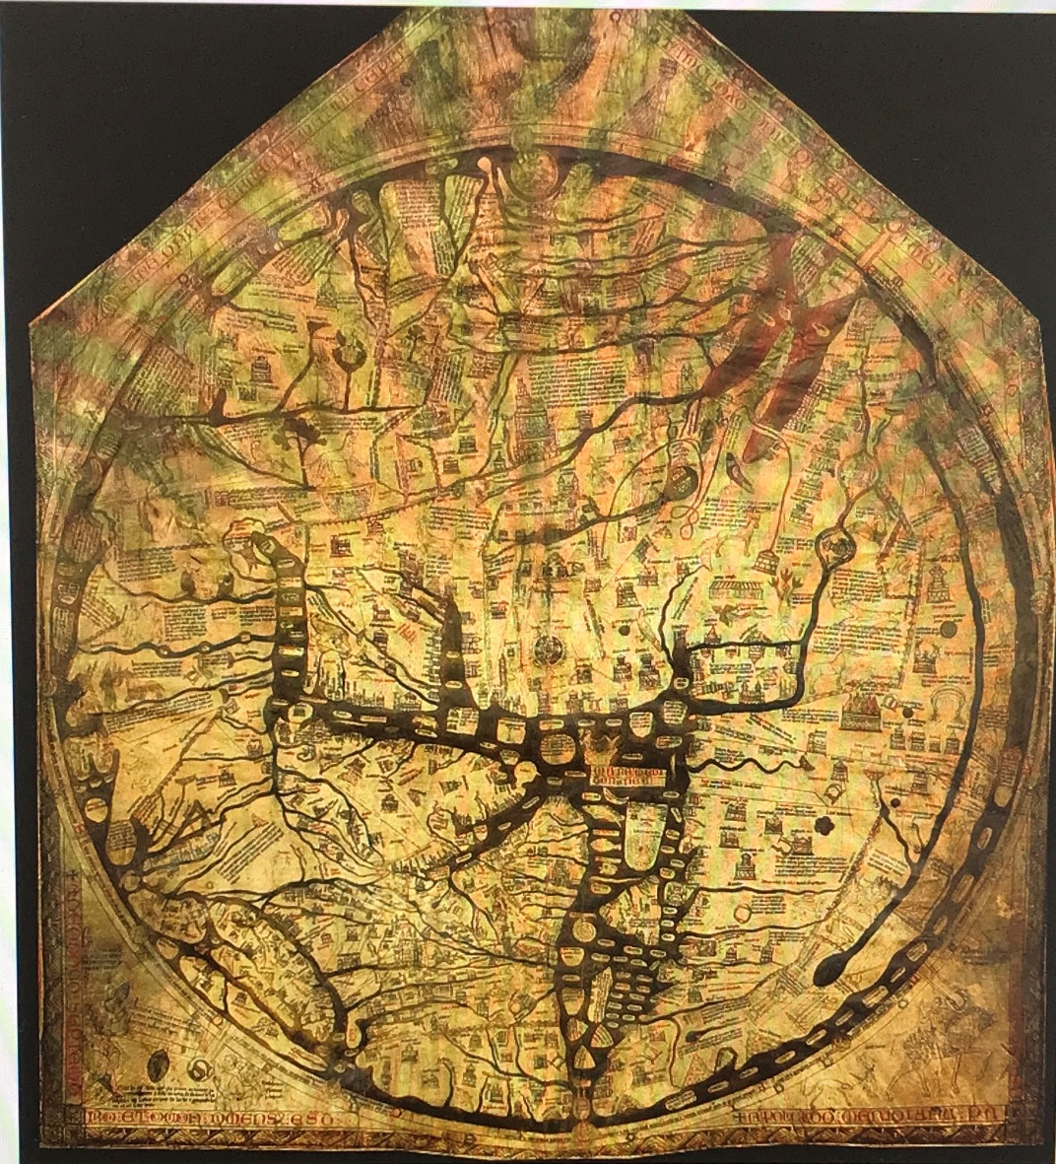
A pan-European Roadmap for Open Science?
Hereford ‘Mappa Mundi’
Largest surviving medieval map
A theological statement
Drawn in Lincoln c. 1300
But Africa is called Europe and vice versa…
England

Slide 18
A Statement which offers a pan-European Roadmap?
Hereford ‘Mappa Mundi’
Largest surviving medieval map
A theological statement
Drawn in Lincoln c. 1300
But Africa is called Europe and vice versa…

Slide 19
So, thanks for listening…
Happy to answer questions

