Slide 1
UK-SCL: introduction and update
M25 Directors’ Briefing
April 2018
Chris Banks @ChrisBanks
https://orcid.org/0000-0002-7735-9412
This work is licensed under the Creative Commons Attribution 4.0 International License.

Slide 2

The “policy stack” challenge
Many funder policies:
  Different compliance requirements
  Differently funded (or not)
Many different publisher policies
  Some publishers have different policies depending on who funds the researcher
REF policy in particular, differs substantially from other policies and applies to all UK academics
Publisher policies are not always in line Funding or Research Council policy
Difficult to know what to do to comply both with Funder and REF policies

Slide 3
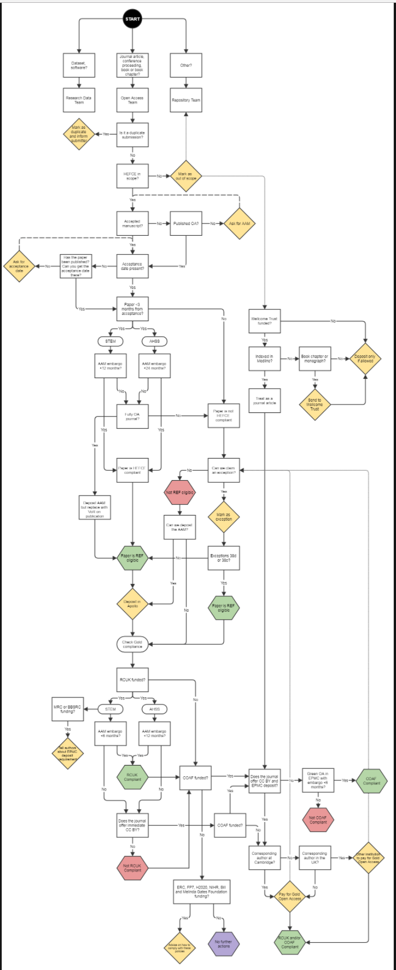
It’s Complicated
You’ve had your idea
You’ve applied for your research grant
You’ve hired the staff, done the research, crunched the data and written your findings up
… then this – all in aid of working out whether your work is compliant with your funder(s) and eligible for the REF
Arthur Smith, Open Access policy, procedure & process at Cambridge
https://unlockingresearch-blog.lib.cam.ac.uk/?p=1613

Slide 4
A particular UK Challenge
Multiple funder and publisher OA policies create a complex “policy stack” – knowing what is best/right can be difficult to figure out. Funders are introducing progressive “open” policies whereas some significant publishers are setting embargo requirements that are either at or below the minimum required by funders with the consequence that opting - and paying - for gold/hybrid open access may be the only means of compliance. This appears to be a particular issue in the UK

Slide 5
A particular UK Opportunity
Funder policies are progressive
  They set minimum criteria and some (REF) will reward those that go beyond those criteria
Academics are covered by multiple funders
  Drives progression - even if going for the minimum compliance, will often end up exceeding the criteria for, e.g., the REF
This combination has made it possible for institutions to consider an even more progressive institutional policy – largely to address complexity but, inter alia, also to support more liberal OA

Slide 6
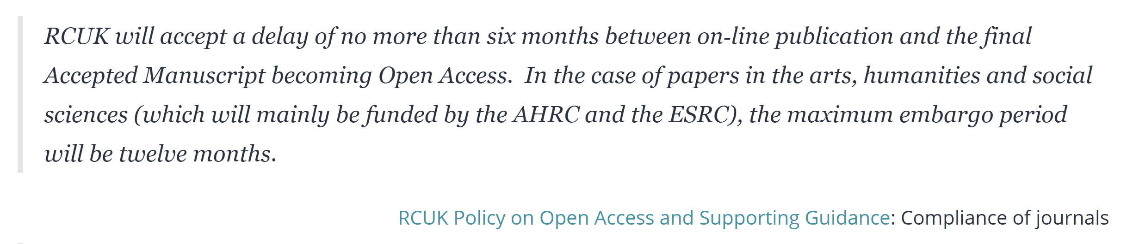
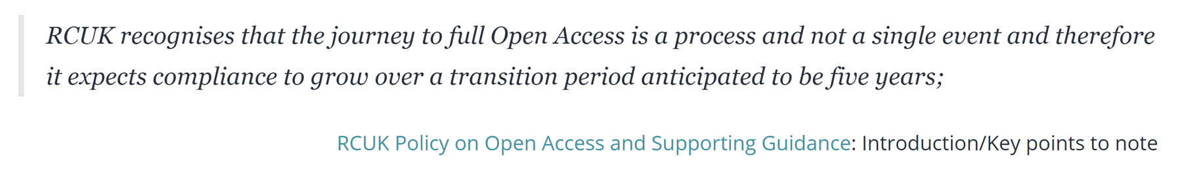
Progressive policy: RCUK

Slide 7
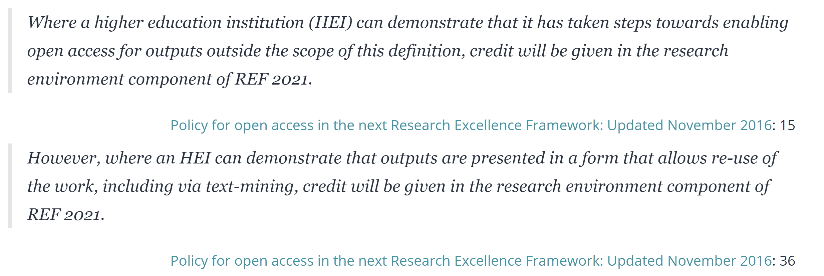

Slide 8
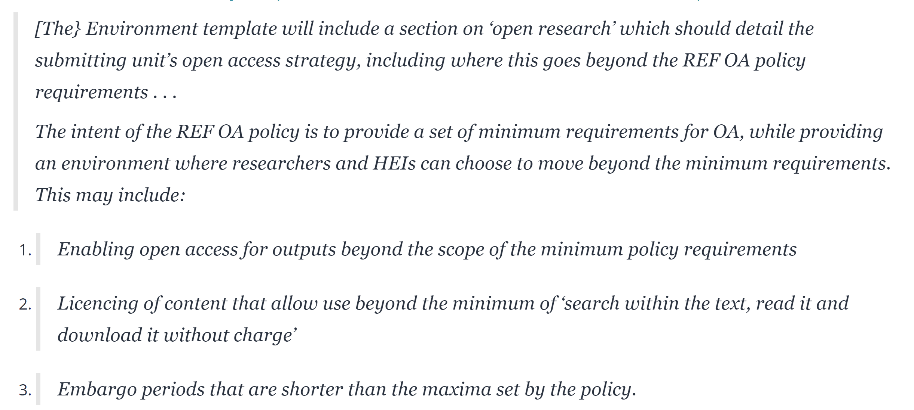

Slide 9
Why institutional OA policy revisions are needed
Need to ensure that institutional policies are in alignment with funder (RCUK, REF, etc.) policies
Publisher policies vary considerably – many do not enable easy compliance with both funder(s) and REF policies
Want to preserve academic choice as to where to publish, including academic freedom to sign whatever licence/© transfer agreement is necessary (whilst separately continuing to encourage scrutiny of those licenses)
Desire to maximise impact of publication
Desire to retain some re-use rights for use in teaching etc., including rights in diagrams and graphs produced for the publication.

Slide 10
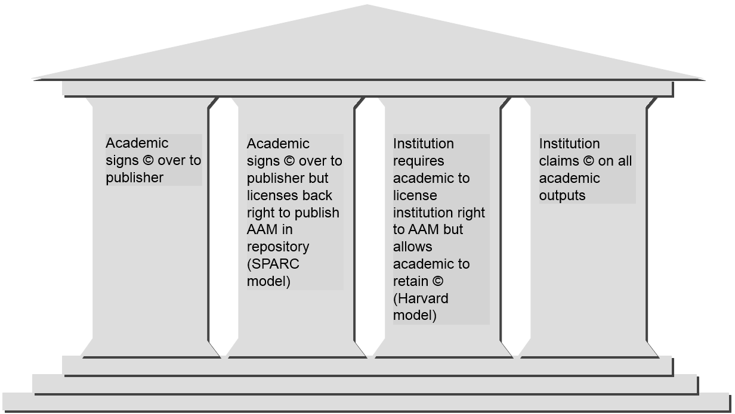
Options explored with academics

Slide 11
Harvard policy chosen by academics
Well established – has been in use since 2008
Allows authors to share and reuse accepted manuscripts (through the grant of a non-exclusive licence to university )
Where a journal seeks a waiver, this can be managed by exception (happens <5% in the USA)
Over 70 implementations
  From Harvard, MIT and University of California
  To smaller institutions, including two in Kenya

Slide 12
Key components of the model policy
Retain the right to make accepted manuscripts of scholarly articles available publicly for non-commercial use (CC BY NC 4.0) from the moment of first publication.
Allow authors to request a waiver for applying this right for up to 12/6 months (AHSS and STEM, REF panels).
Allow publishers to request a blanket waivers for applying this right for up to 12/6 months (AHSS and STEM, REF panels).
Supports academics whose only option is to self-archive, or who choose to self-archive

Slide 13
Three parts to the SCL
Rights retention on behalf of the academic: these rights come into existence at the point the AAM comes into existence. The rights are then transferred back to the academic(s)
Licence on deposit: the default is CC BY-NC in line with the minimum requirements for RCUK. We recently added the option for a ND choice for those with no funder requirement to have the more liberal default licence
AAM availability through the repository: default is zero months after publication (earlier if publishers allow). For an interim period publishers can apply for blanket 6/12 month embargos also in line with minimum RCUK requirements

Slide 14
Authors can…
retain more rights in their own work
continue to publish in journal of choice
make their work OA through self-archiving
reuse own work in research and teaching
minimise reliance on increasingly expensive hybrid OA
meet funder requirements
Ensure elibitility for the REF

Slide 15

Funder policy clarifications
http://ukscl.ac.uk/funder-policy-statements/

Slide 16

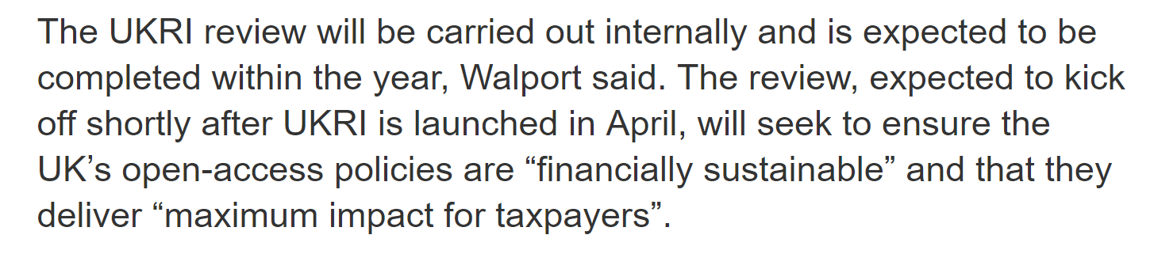
Upcoming review
https://www.researchprofessional.com/0/rr/news/uk/open-access/2018/2/UKRI-looks-to-tighten-grip-on-hybrid-journals.html

Slide 17

The lightning rod effect
Rick Wilson, CC BY-NC https://phys.org/news/2016-12-lightning-fossil-energy.html

Slide 18
Where are we now with the UK-SCL?
Progressive funder policies add backbone to the initiative
Significant sectoral interest and engagement
Strong institutional and support @ Imperial and elsewhere
Publisher engagement suggests that we are on the right track
Policy makers are taking notice and seeing it as part of their solution, c.f. UKRI
Publisher lobbying:
  Funders
  Academics
  Learned Societies
Implementation concerns – some of the concessions add back complexity into the administration of the policy

Slide 19
Where we next need to focus our attention?
Academics: engage on the benefits to them, understand the demand for change, understand their concerns and perceptions
Engage with a broader community concerned about © transfer
Learned Societies: work together to understand the support needed for transition
Implementation: work on a pragmatic achievable phased adoption and implementation with a group of universities
Set out what the longer term goals of the initiative are
Analyse data from the first five years of Finch – where has the real transition impact been seen?
Work with funders, particularly UKRI and the open science review to inform how any further funding for a transition might best be allocated and how the UK-SCL might form part of the solution

Slide 20
Ongoing engagement
Publishers (via the Publishers’ Assocaition)
Academics (via institutions and learned societies)
Policy makers

Slide 21
Questions
Soft launch: adopt the policy but make licence choice and deposit optional/opt-in?
  Allow a choice of a more restrictive licence at deposit?
Does the SCL approach force a more balanced discussion about an affordable gold model or perpetuate the subscription model?
How threatening are the threats to publishing choice?
We describe the SCL as an interim measure but we haven’t articulated the destination. Can we?
Is it necessary for © to be transferred to the publisher? Would a licence to publish be sufficient instead?

Slide 22
Further reading & watching
Banks, C., (2016). Focusing upstream: supporting scholarly communication by academics. Insights. 29(1), pp.37–44.
DOI: http://doi.org/10.1629/uksg.292
Torsten Reimer, UK Scholarly Communications, Licence and Model Policy, https://zenodo.org/record/153928#.WLaz9G-LREY
“Focusing upstream” – recording of talk given at UKSG 11 April 2017: https://tv.theiet.org/?videoid=10043
“Copyright and Licensing session : Rights as the foundation of scholarly communication” – outputs (ppt and recording) from talk given at the OAI10 – CERN – UNIGE Workshop on Innovations in Scholarly Communication https://indico.cern.ch/event/405949/contributions/2487876/
Responses to concerns raised by the Publishers’ Association: http://bit.ly/2yAmyRm and http://bit.ly/2yFUkDW

Slide 23
ukscl.ac.uk

