Slide 1
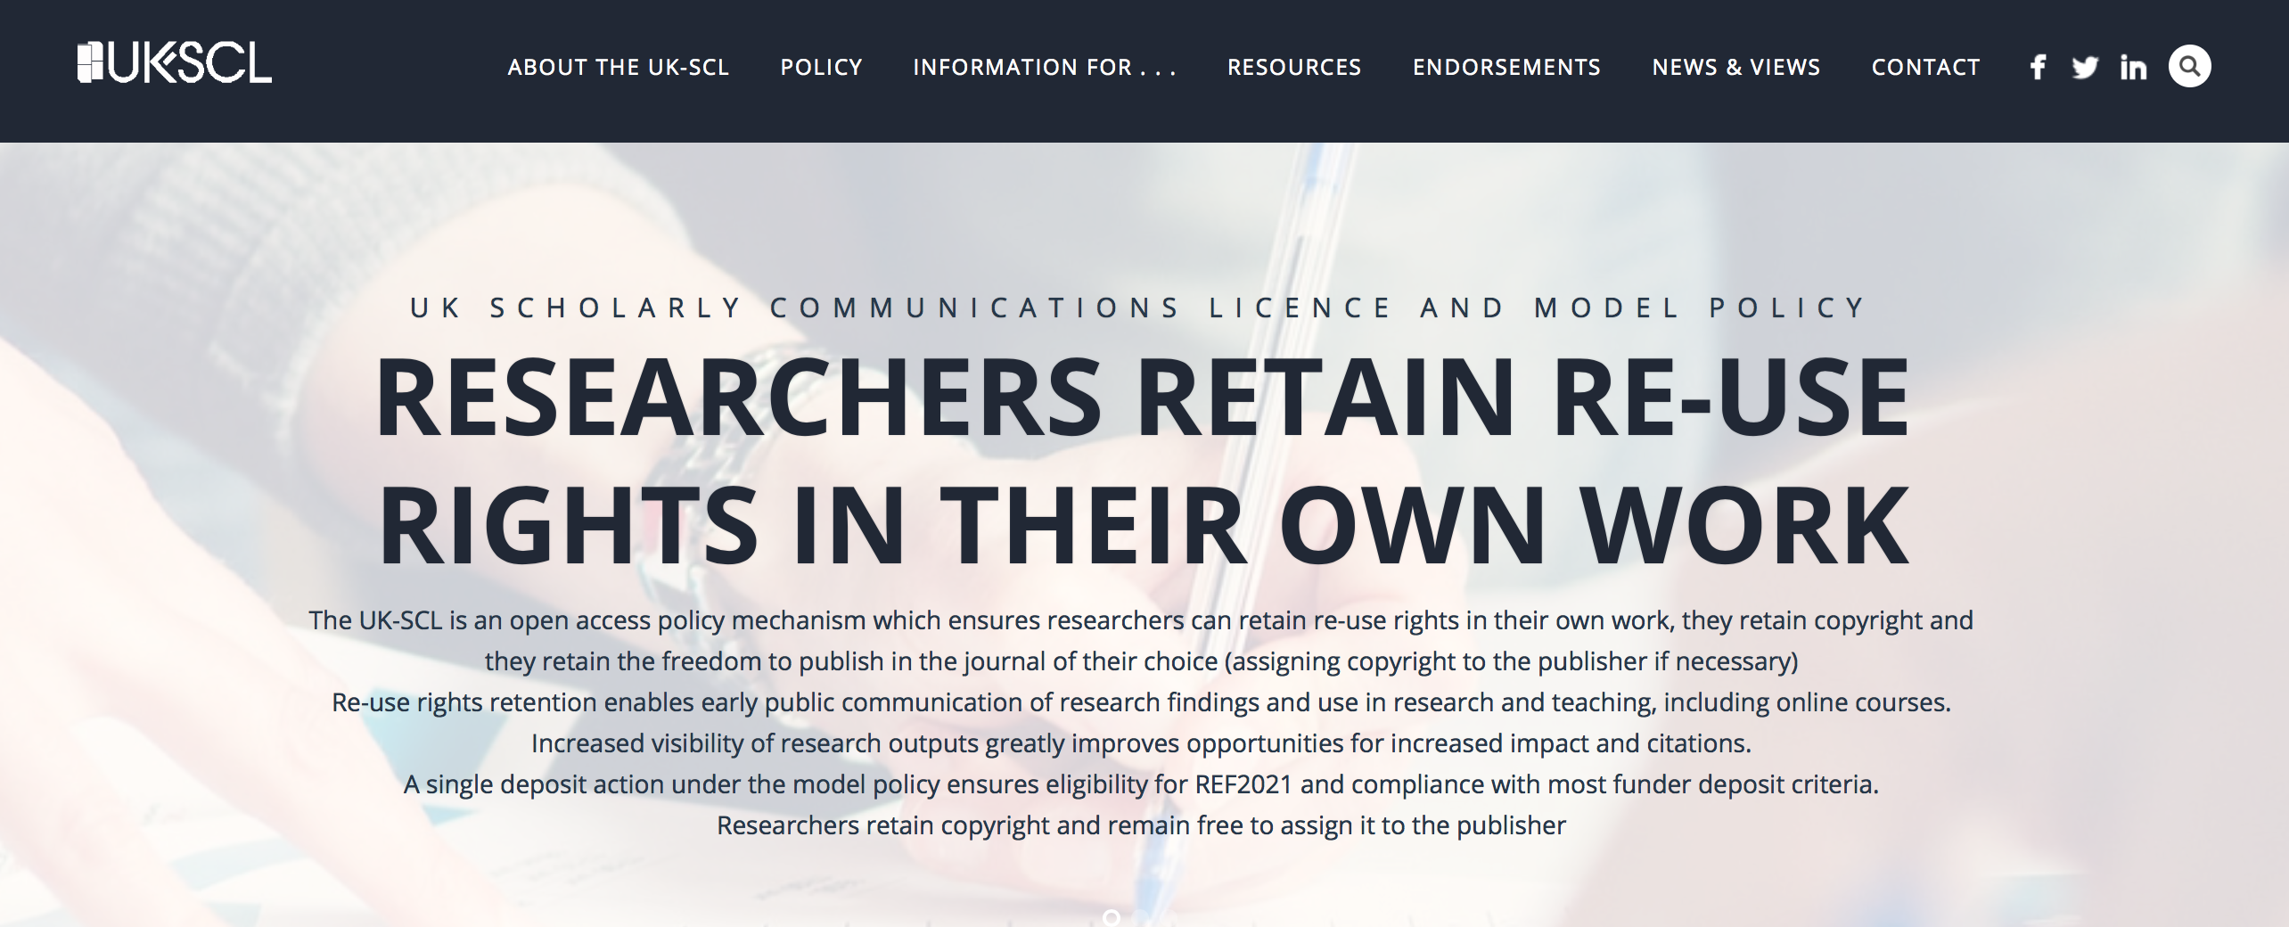
UK-SCL: An academic perspective
Freedom, responsibility and control
Stephen Curry
Imperial College London
16 April 2018

Slide 2
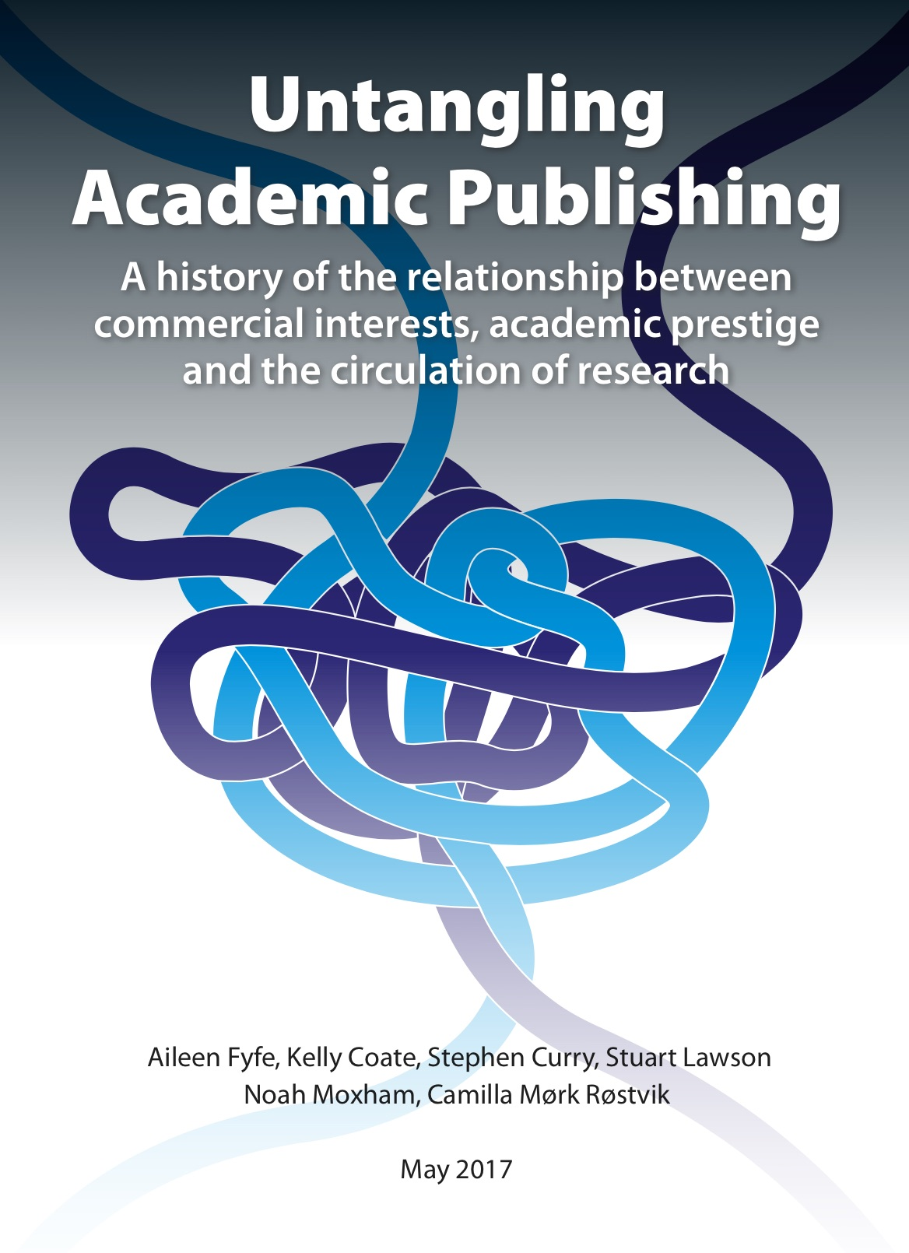
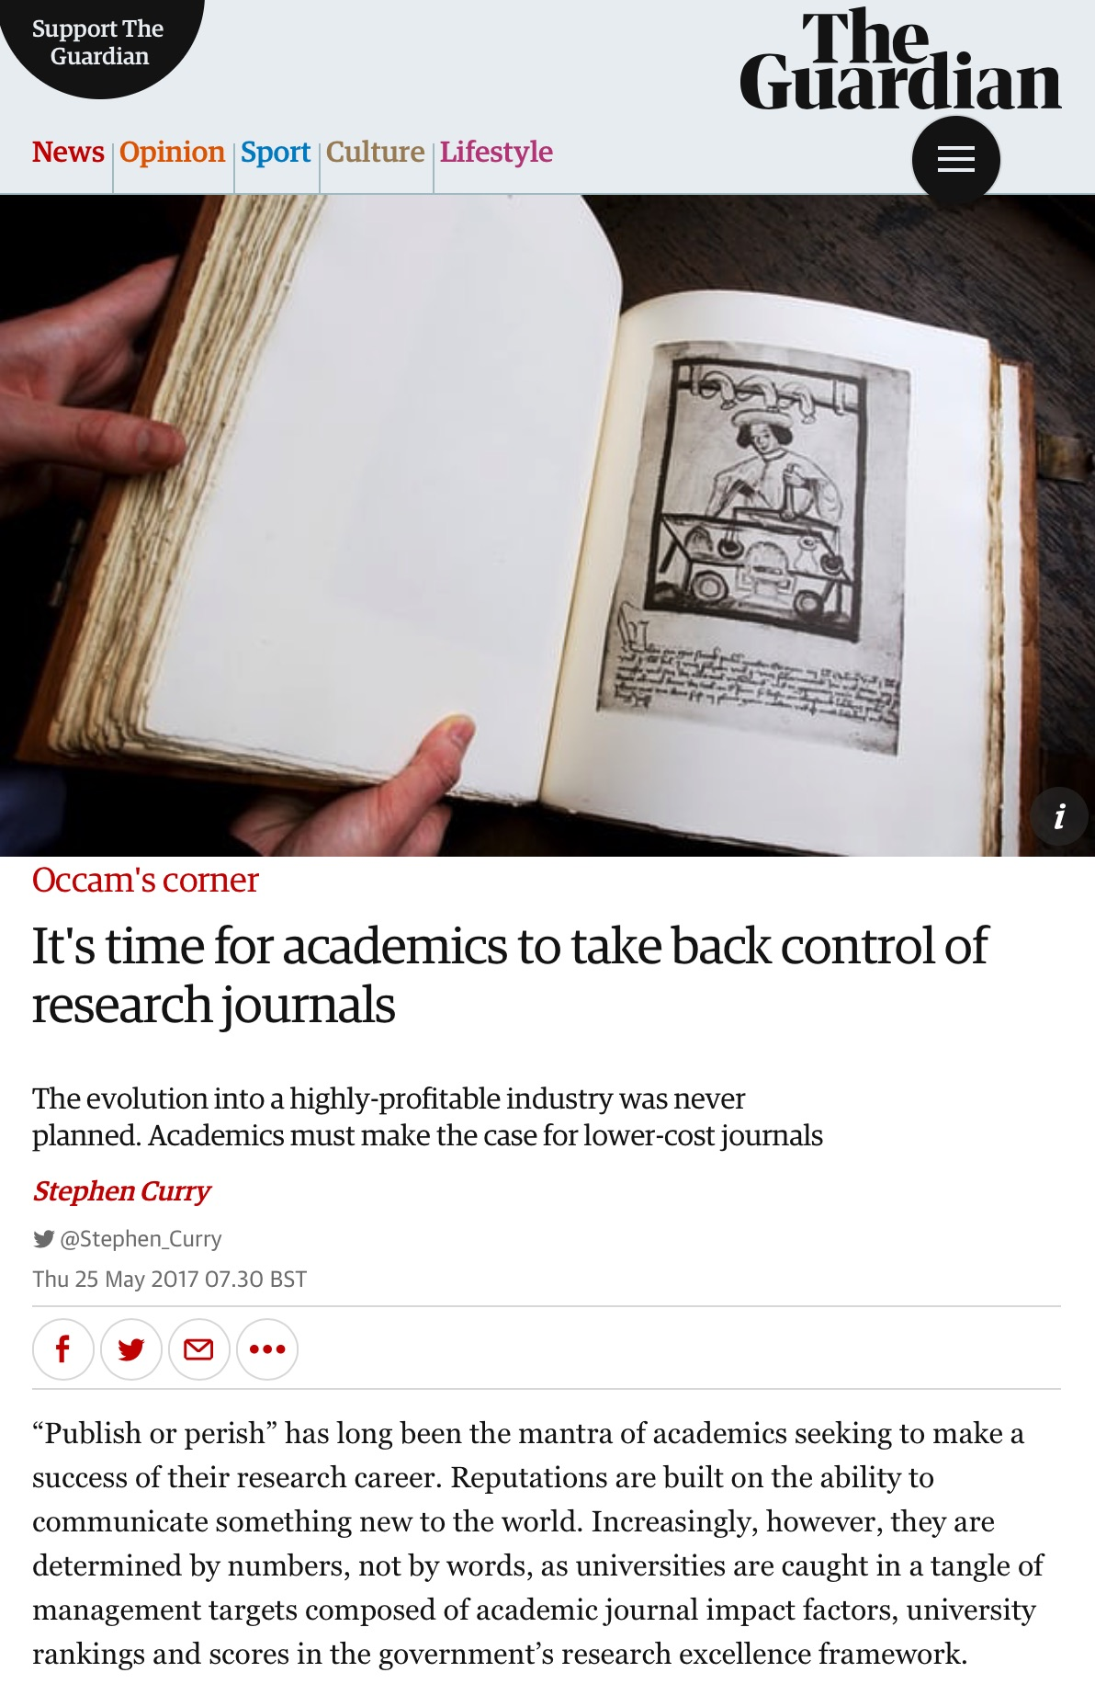
Background reading
“Here’s @Stephen_Curry calling for communism…”
https://zenodo.org/record/546100

Slide 3
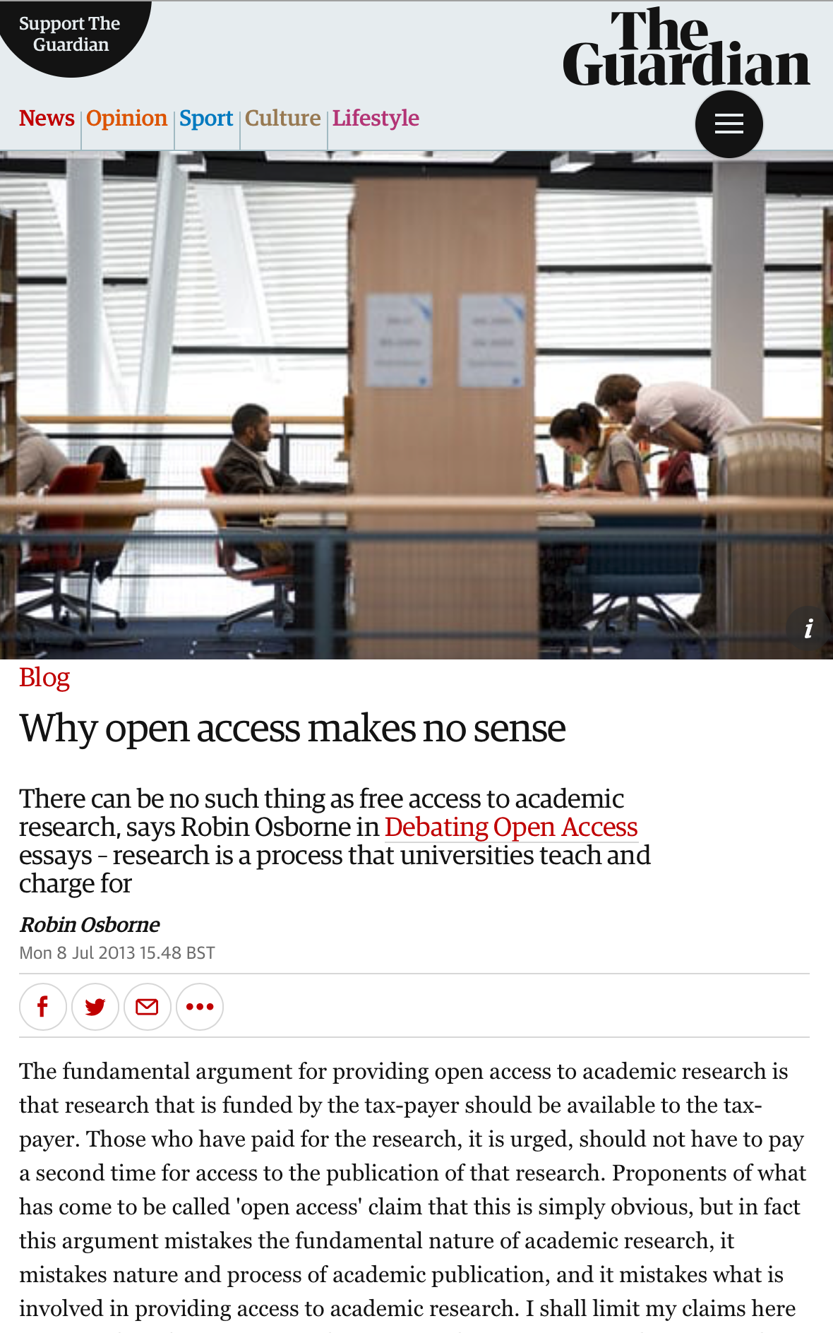
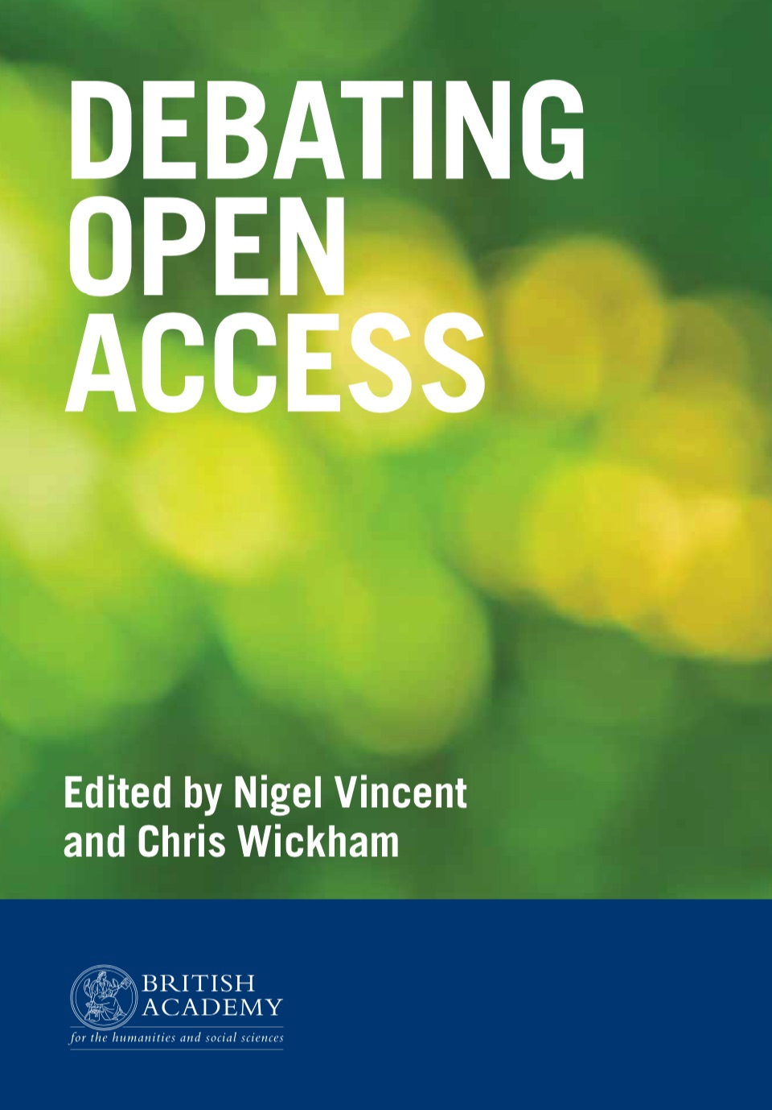
Open access is important – but not to everyone…
“Academic research is not something to which free access is possible. Academic research is a process – a process which universities teach (at a fee)…”
“For those [others] who wish to have access, there is an admission cost: they must invest in the education prerequisite to enable them to understand the language used.“
https://amp.theguardian.com/higher-education-network/blog/2013/jul/08/open-access-makes-no-sense

Slide 4
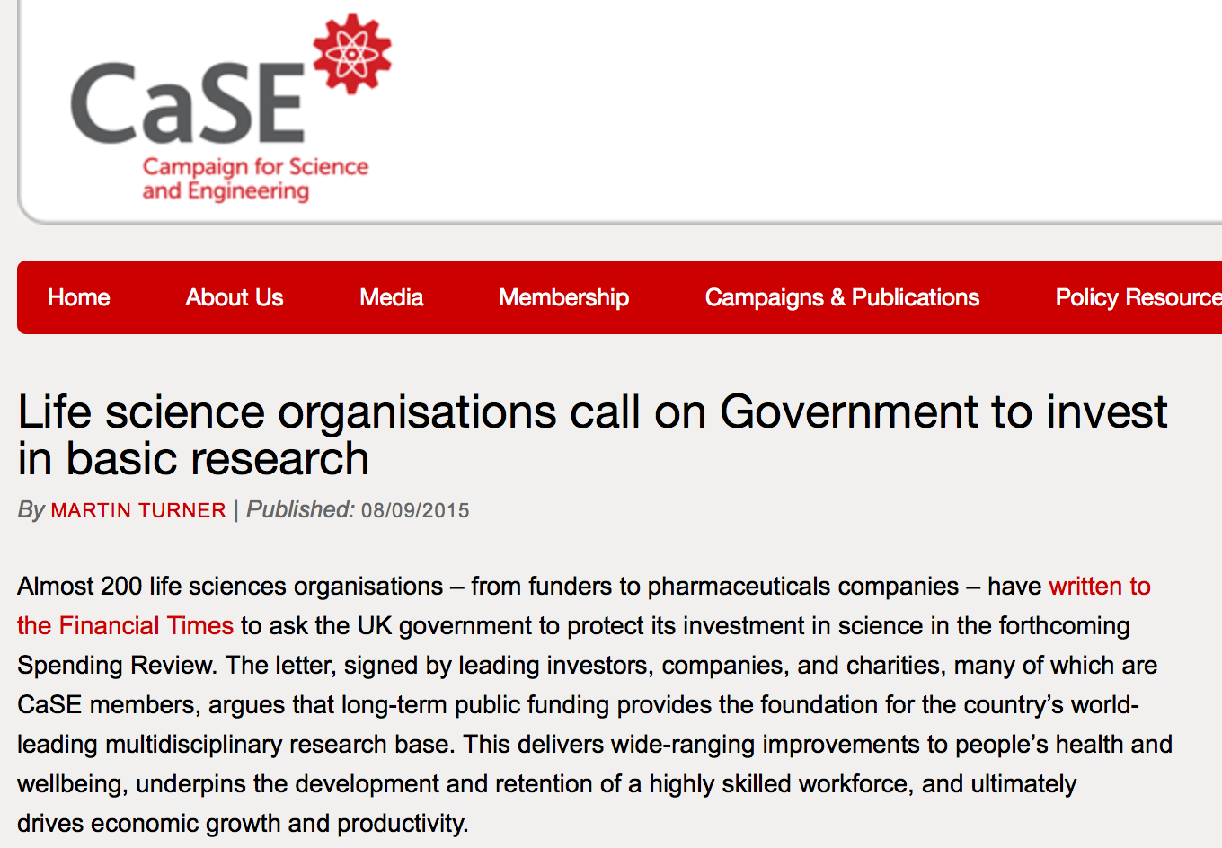
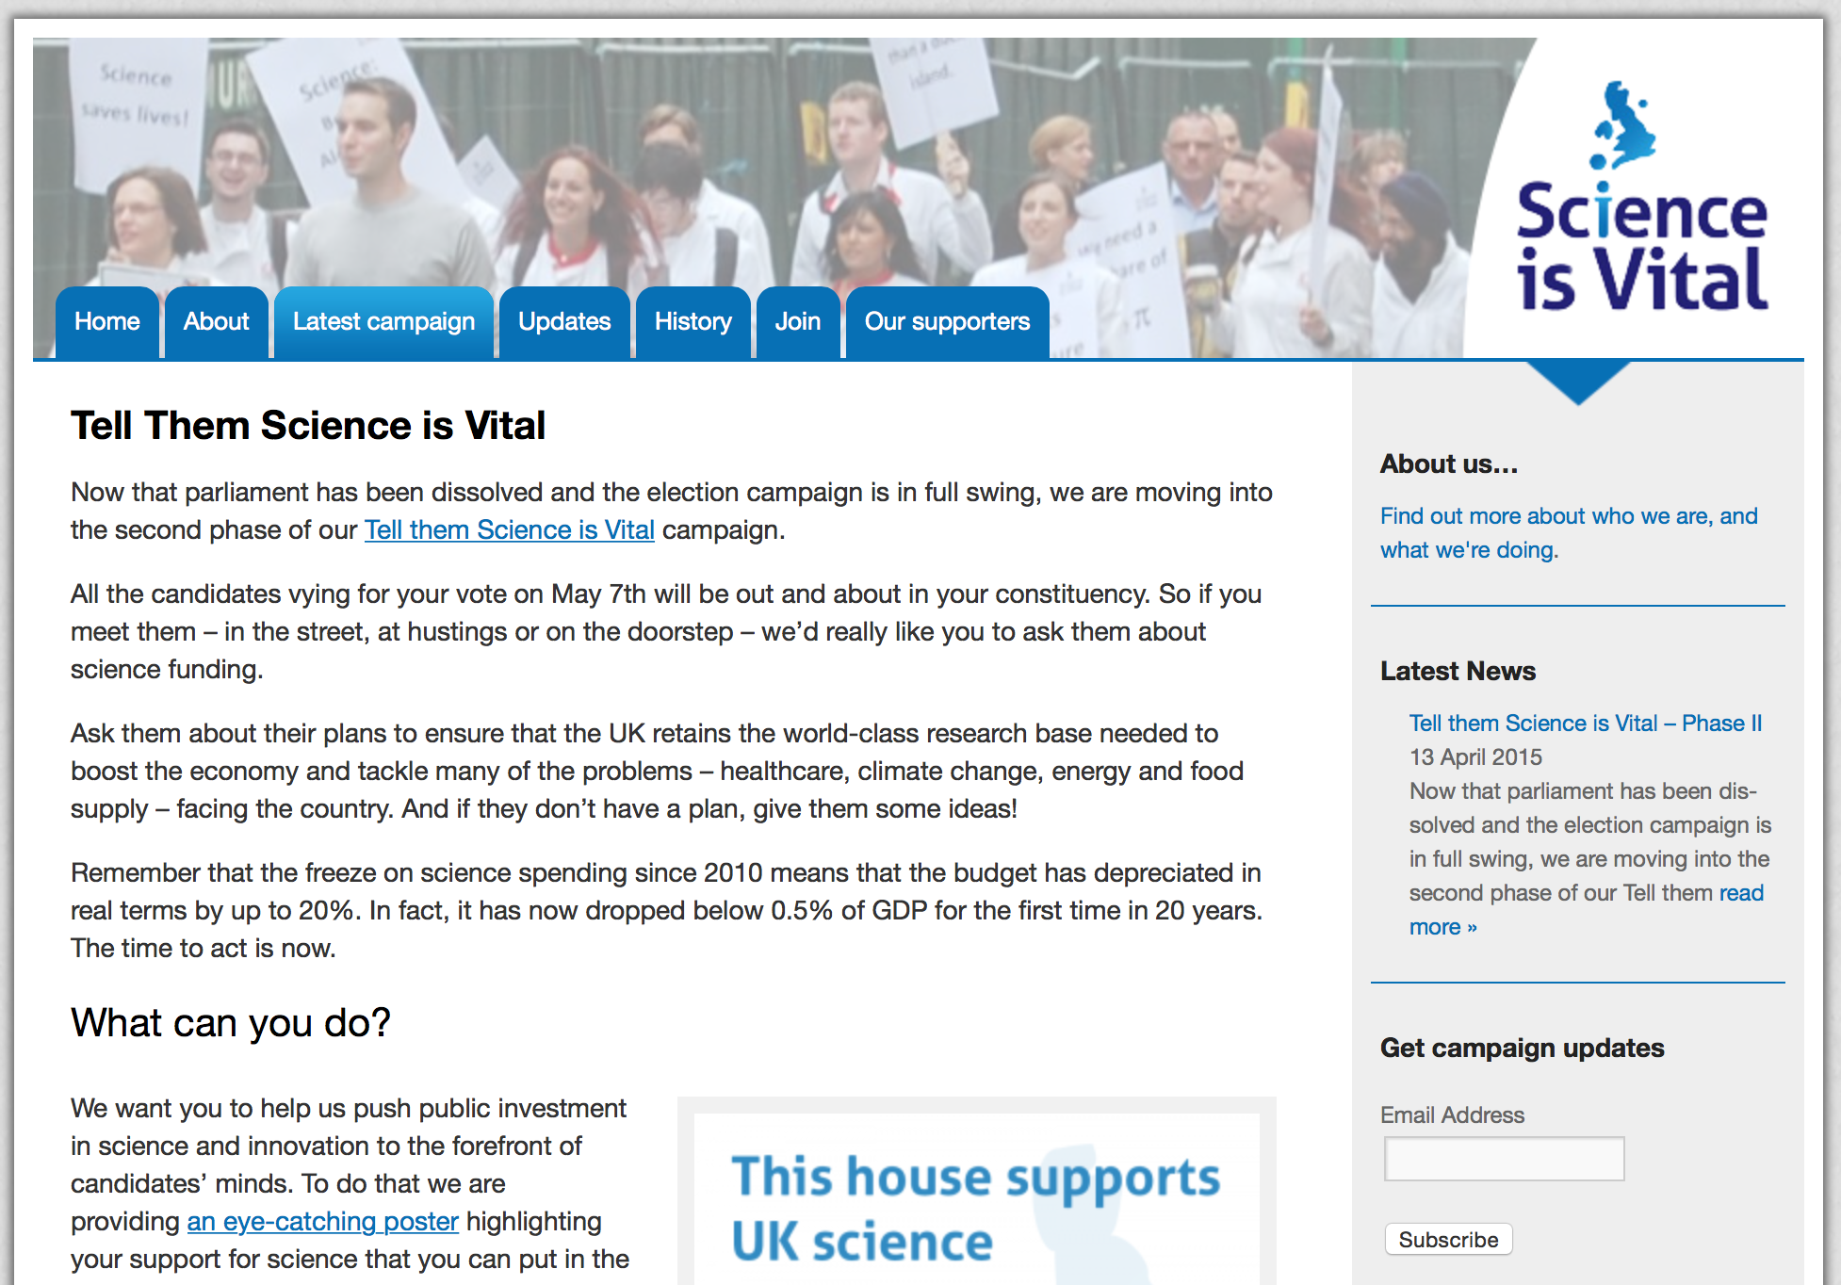
Academic freedom is important – but not for everyone?
Sarewitz’s article and responses – https://www.thenewatlantis.com/publications/must-science-be-useful

Slide 5
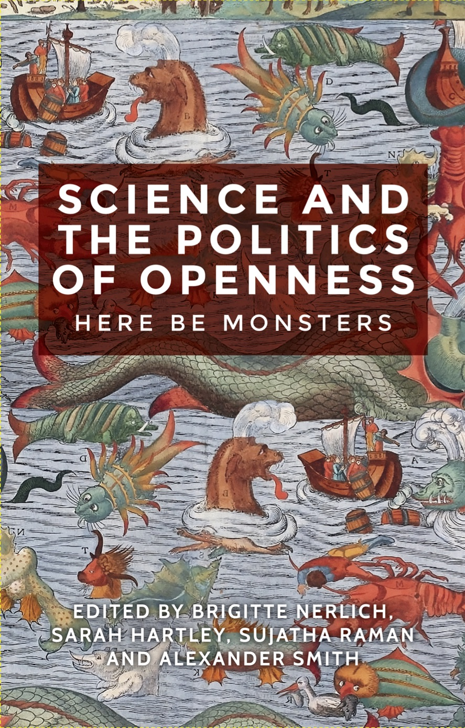
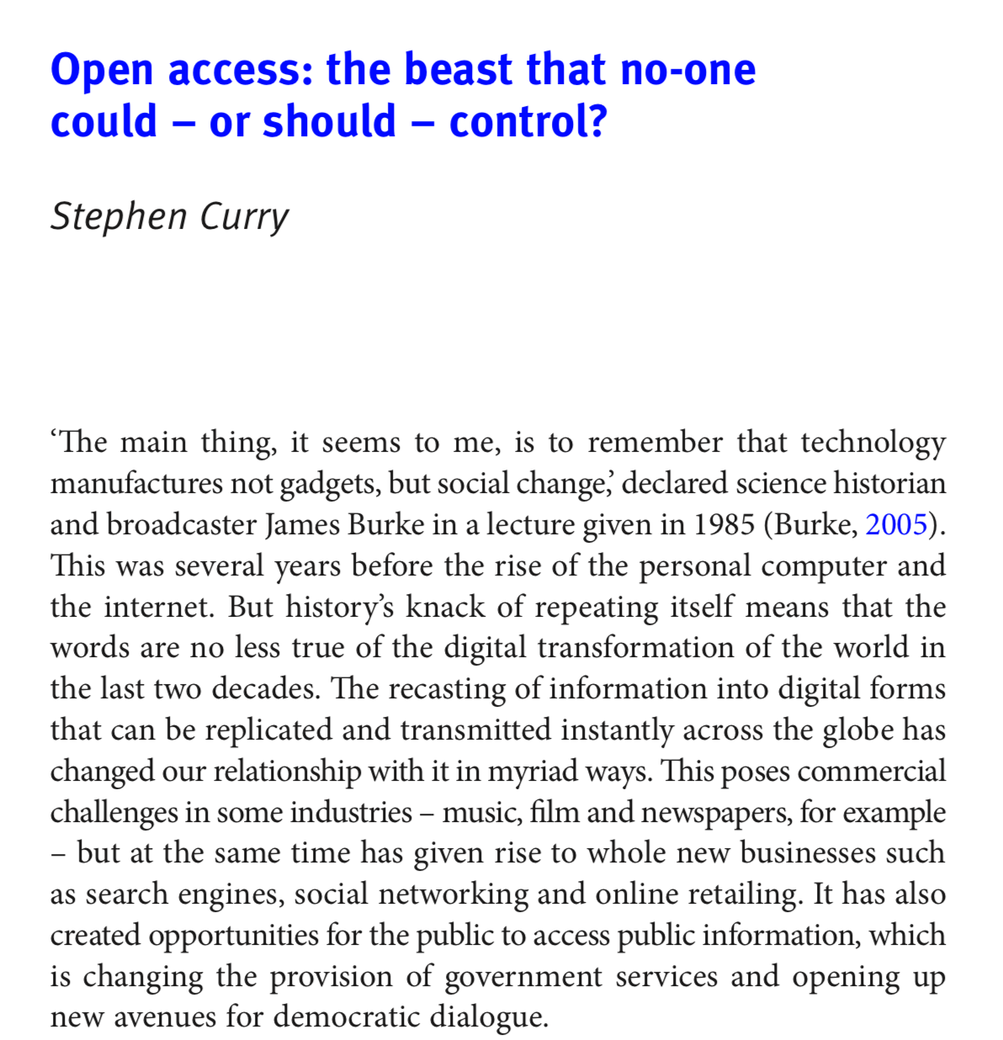
Open access – freedom and responsibility
Rick Anderson: Does academic freedom include the right to choose where to publish?
Richard Poynder: Is the linkage of OA policy to the REF “coercive”?
http://oapen.org/search?identifier=643155

Slide 6
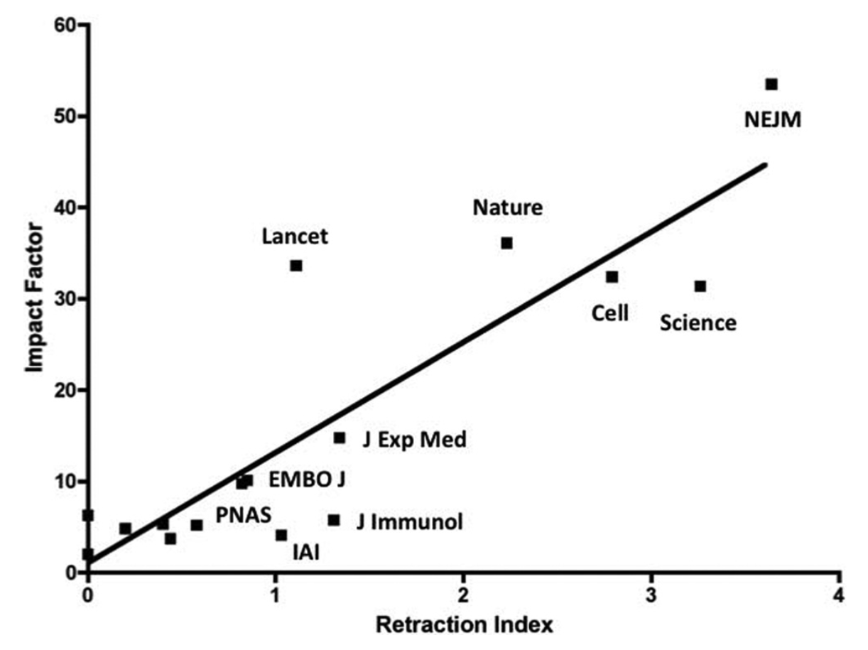
Focusing researcher assessment on publishing is problematic
The prestige economy is expensive (subscriptions & APCs)
Publication is slowed by the impact factor chase
Novelty & positive results are favoured over reproducibility
Incentivises fraud
Weakens public trust…
http://iai.asm.org/content/79/10/3855.full
Impact factor
Impact factor
http://occamstypewriter.org/scurry/2012/08/13/sick-of-impact-factors/
http://journals.plos.org/plosmedicine/article?id=10.1371/journal.pmed.1001747
Retraction Index

Slide 7
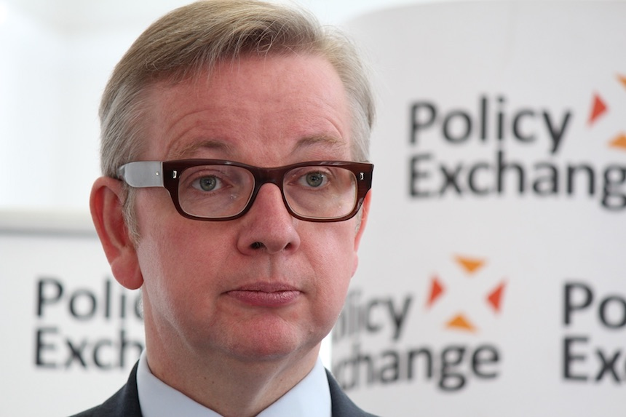
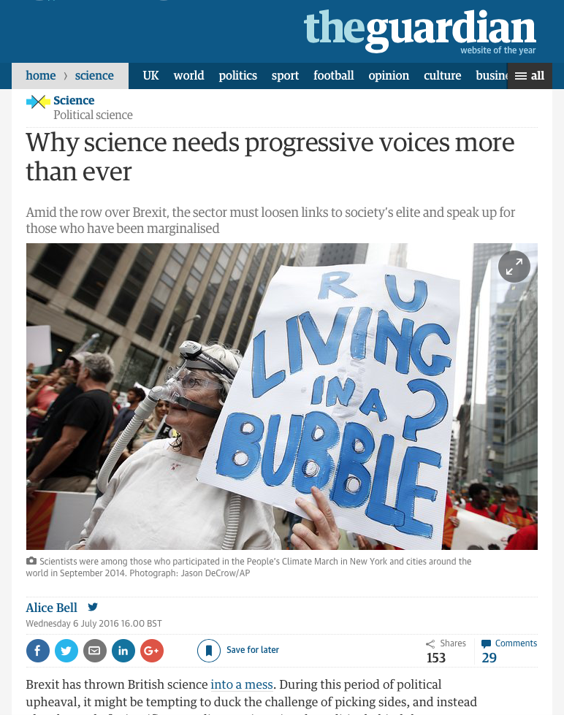
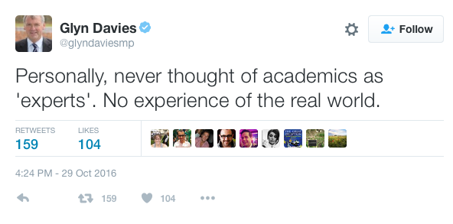
We cannot afford to weaken public trust
“too often [public engagement initiatives] fail to build meaningful relationships between science and the public, preferring instead to act as fluffy PR agents for the scientific establishment. We badly need more projects […] that share the benefits of expertise and lets people feel part of driving science and engineering.”
Alice Bell
“People in this country have had enough of experts.”
Michael Gove, MP
https://www.theguardian.com/science/political-science/2016/jul/06/why-science-needs-progressive-voices-more-than-ever

Slide 8
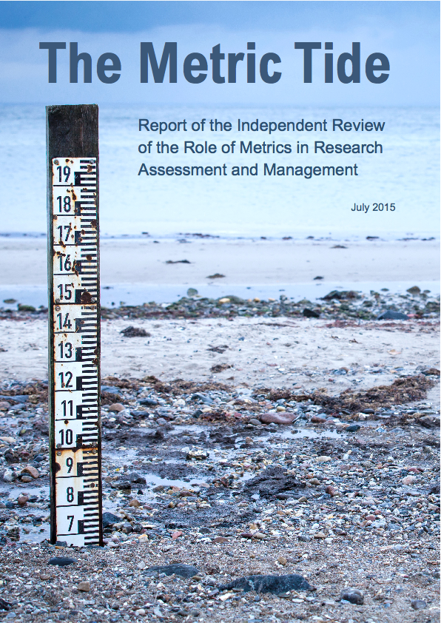
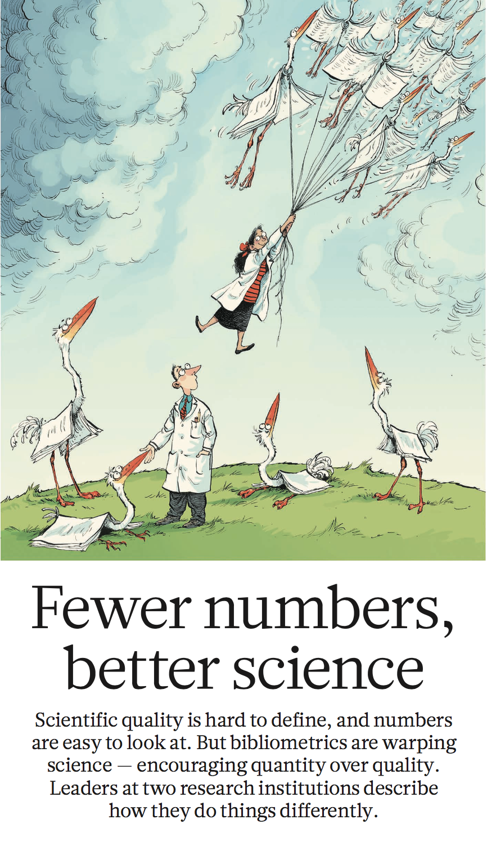
Can we swim against the metric tide?
Vale, R. D. (2012) Mol Biol Cell 23, 3285–3289.
http://www.nature.com/news/fewer-numbers-better-science-1.20858
http://sfdora.org
Researcher assessment at UMC Utrecht
Research, publications, grants
Managerial & academic duties
Mentoring & teaching
Clinical work (if applicable)
Entrepreneurship & outreach

Slide 9
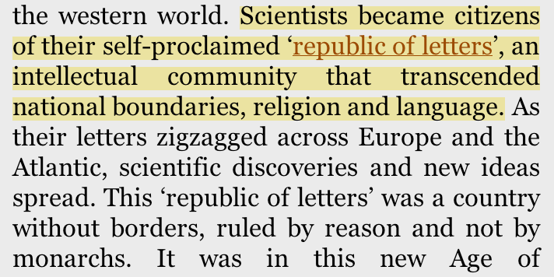
Can the openness of our scientific heritage help us?
Does the republic of letters still exist?
Is our amateur (and open) ethos still one of the norms of the academy?

Slide 10
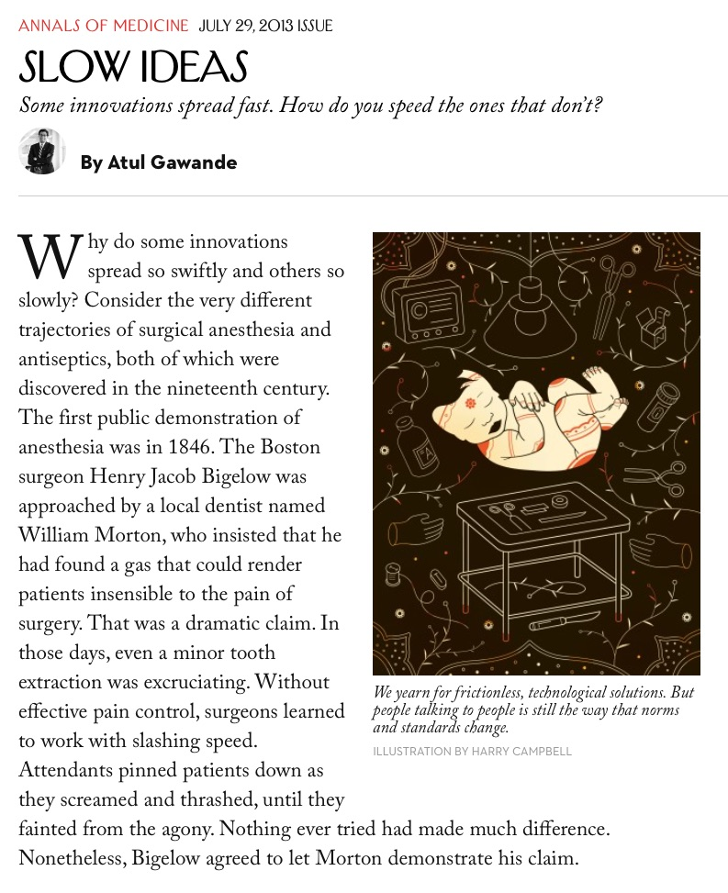
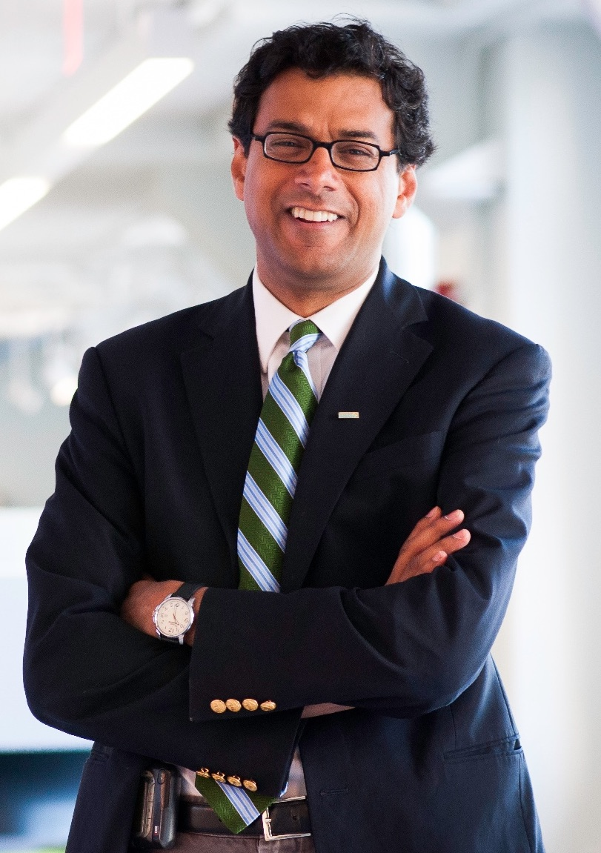
Good (open) practices don’t spread by themselves
Why was anaesthesia adopted more rapidly than antisepsis?
“First, one combatted a visible and immediate problem (pain); the other combatted an invisible problem (germs) whose effects wouldn’t be manifest until well after the operation.
“Second, although both made life better for patients, only one made life better for doctors.”
“People talking to people is still the way that norms and standards change.”
http://www.newyorker.com/magazine/2013/07/29/slow-ideas

Slide 11
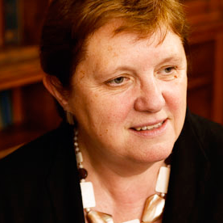
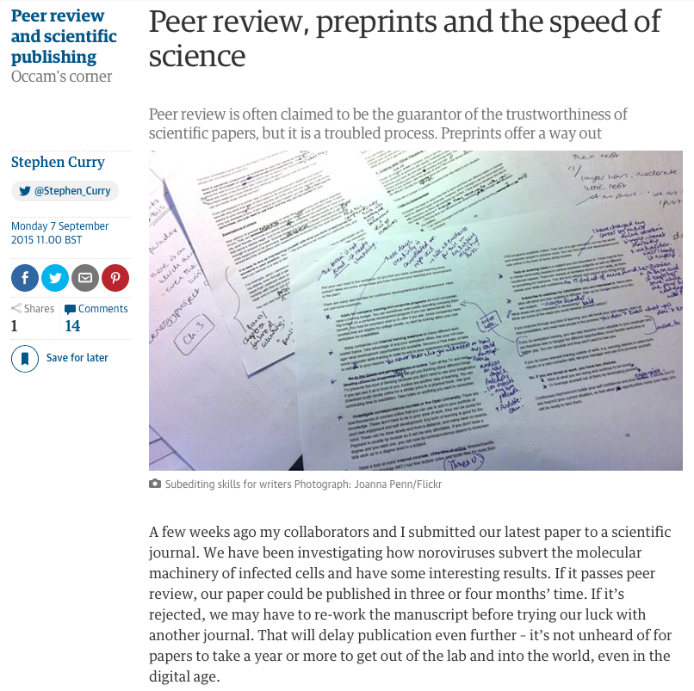
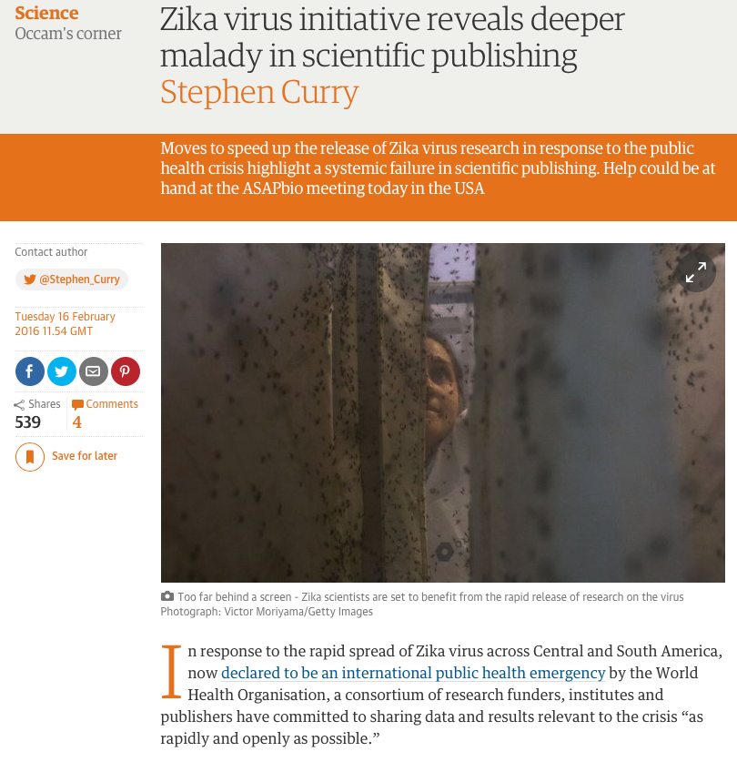
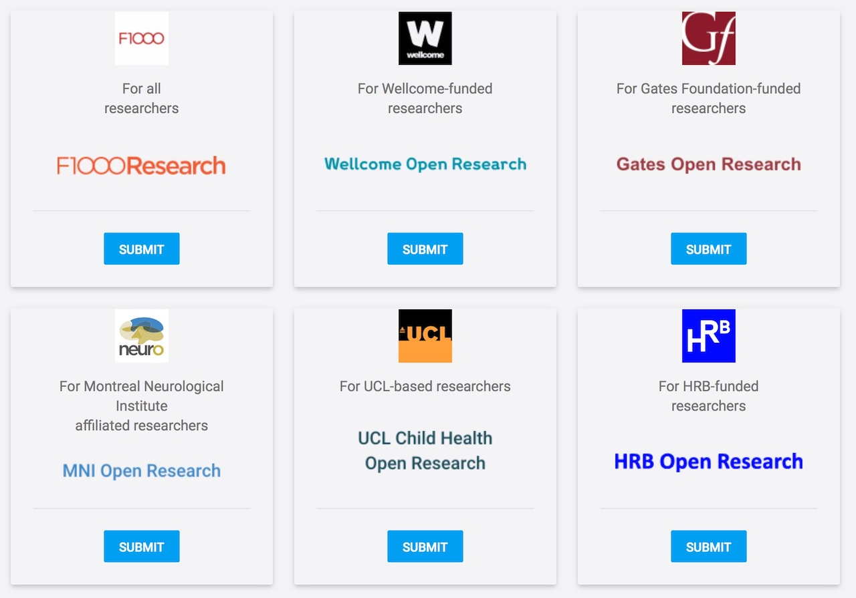
Openness as a good in itself: a path to greater scientific integrity, impact and public trust
Declarations are not enough…
Positive moves:
Funder mandates (what will UKRI do next?)
Funder support for preprints & OA mega-journals: faster, open, better…
Largest possible audience (sharing & scrutiny)
Fosters open peer review
Focus on the content, not the container (‘objective' peer review)
“The principle that the results of research that has been publicly funded should be freely accessible in the public domain is a compelling one, and fundamentally unanswerable.”
Dame Janet Finch (2012)

Slide 12
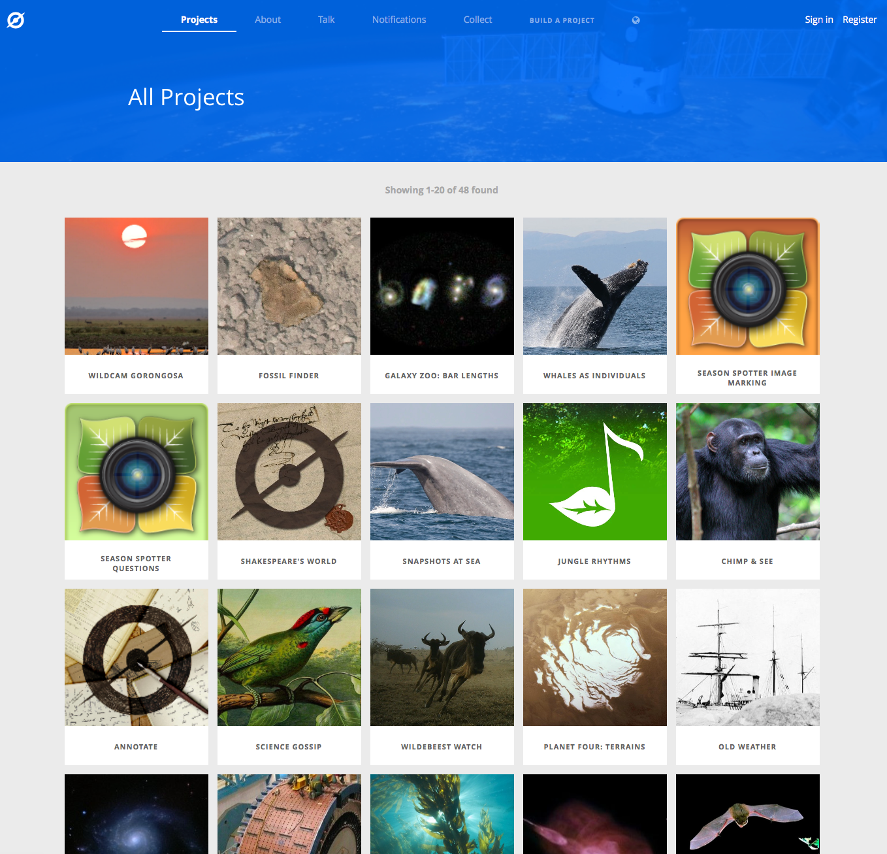
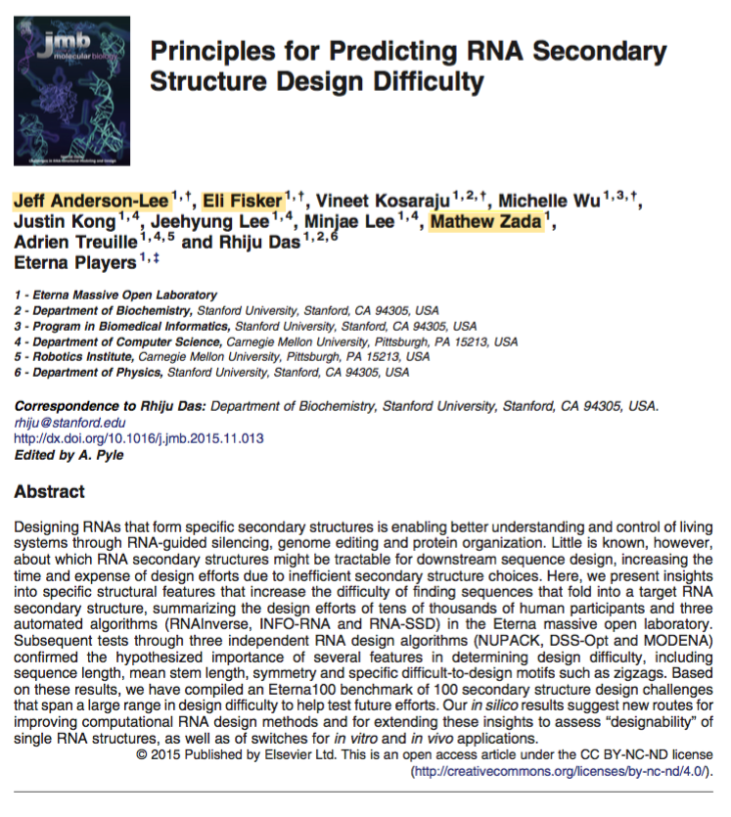
Openness as a good in itself: a way to involve the public
Citizen science teaches researchers about:
new (non-traditional) audiences & scientists
Communication + Participation = Public Trust
Notes:
Not just talk - reward (also transmitted through culture, praise)

Slide 13
“People talking to people is still the way norms and standards change.”
“We would ask scholars to consider the responsibilities that sit alongside academic freedom and to reflect on whether they might re-prioritise the duty to communicate rapidly and widely in the face of the reputational credit that is earned through publication. Given the crucial role that academics play in peer review, we occupy a central and influential position.”

