Slide 1
The Royal Society and UK-SCL
Dr Stuart Taylor
Publishing Director

Slide 2

The Royal Society
The national academy of sciences for the UK and Commonwealth
Founded in 1660; Royal charter in 1662
Fellowship of 1600 of the world’s most eminent scientists
The Society’s fundamental purpose is to recognise, promote, and support excellence in science and to encourage the development and use of science for the benefit of humanity.

Slide 3
What do learned societies do?
Promote and represent the interests of a specific discipline or group of disciplines
Act as a convening organisation to promote discussion
Provide expertise to policymakers (‘science for policy’)
Advocate for research policy (‘policy for science’)
Fund research
Recognise excellence
Set standards
Public engagement
Validate, register, disseminate and archive research findings (“publishing”)

Slide 4
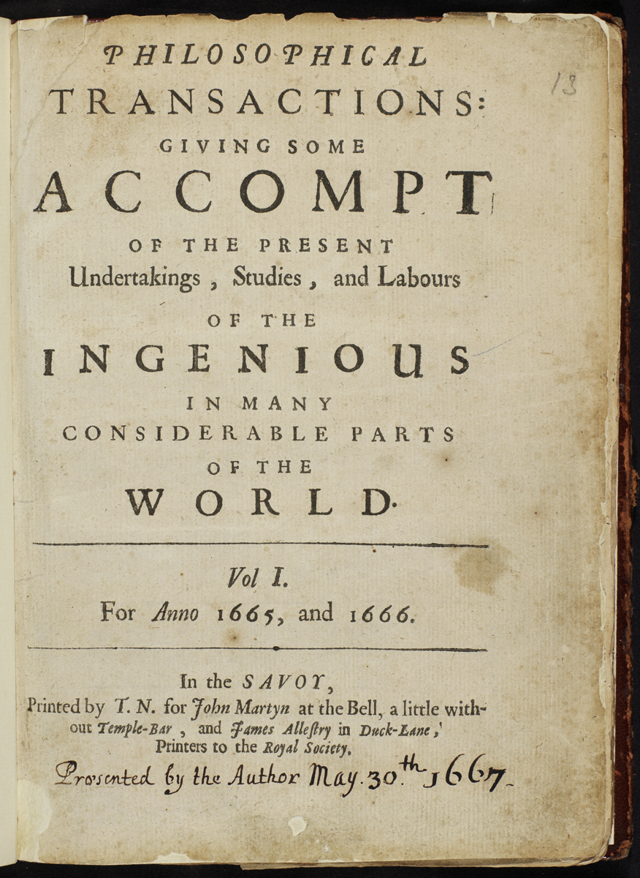
March 6 1665
Philosophical Transactions

Slide 5
A bit of history
For over 300 years, Royal Society journals were a drain on the finances (often considerably so)*
We distributed free copies all over the world (early ‘open access’)*
Only in the 1970s did our journals start to make a modest surplus
Only since 2000 has this surplus been significant
So…
For most of our history, scholarly communication was considered so valuable that we were prepared to spend precious resources to do it.
How should this inform what we do in the future?
* Fyfe (2015) Notes Rec. 69 277-299

Slide 6
Mission alignment?
Publishing science has served two mission objectives for learned societies:
1. Validation and dissemination of research findings; curation of the literature
2. Generation of funds to support other activities (at least, since the 1970s)
In the print era, these objectives were aligned
In the internet age, they are not
…restricting access is more lucrative than providing it…

Slide 7
What are other societies doing?
There is a very wide range of attitudes to this dilemma
It is not the case that commercial publishers have one view and learned societies another
Some societies are very commercially focussed and tend to oppose open science reforms and strongly protect copyrights
Others are completely focussed on openness and are looking to develop fully funded, platinum OA models
Most are somewhere in between and see the mission conflict as a concern/dilemma/reputational risk
Most societies with journals are dependent on publishing incomes (some existentially so)

Slide 8
Conflicts
Examples of practical aspects of publishing policy which involve mission conflicts
Digital Journal Archive - 11 - 69 years old content is not free because opening it may threaten subscriptions
Hybrid APCs - they could be lower (closer to our costs)
Page charges - increasingly resented by authors, but abolishing them would hit income
Subscription prices - why do we raise them when the journals are already highly profitable? Why not freeze them, or lower them?
RSOS - the community would have preferred us to keep it free for authors, but we started charging APCs in 2018 to generate an income stream
Licence - our licence doesn’t allow authors to share their articles on academic sharing networks, despite the obvious benefit to research, as we are concerned about the effect on subscriptions
ORCID mandate for authors - no business advantage to us (in fact, potential disadvantage), yet we did it for the greater good, involves additional time and cost
Open peer review - no business advantage to us (in fact, potential disadvantage), yet we did it for the greater good, involves additional time and cost
TDM - we allow TDM by subscribers for any purpose, yet we could restrict this and make money out of it as a service.
Data sharing - we require all authors to share their data, provide a DAS and we pay for their Dryad deposits. All requires extra resource and cost

Slide 9
Progress towards open science
2006 - introduced open access option in all journals
2009 - introduced data sharing policy in all journals
2011 - launched first open access journal
2014 - launched second open access journal
2014 - started open peer review (OPR)
2015 - introduced author contribution statements
2015 - signed Transparency and Openness Promotion (TOP) guidelines
2015 - introduced Registered Reports
2016 - mandated open data on all journals (‘encouraged’ since 2009)
2016 - first publisher to introduce an ORCID mandate for authors
2016 - statement encouraging authors to post preprints
2017 - extended OPR to two more journals
2017 - mandated Data Availability Statements for all articles
2017 - appointed a preprints editor for Proceedings B
2018 - launch of evidence synthesis article type in three journals

Slide 10
Our progress to open access
Today : two OA journals, eight hybrids, 3000 articles / year, £7.5m

Slide 11
UK-SCL
Gold open access does not represent a complete solution
authors from low income countries
unfunded/independent authors
disciplinary differences
uncertainty about funder support
The open access ‘policy stack’ in the UK
publishers all have different policies
funders all have different policies
institutions all have different policies
research assessment (REF)
Amidst general confusion among academics, there is a need for a single solution

Slide 12
The ‘publisher view’
There is no single ‘publisher view’ of the UK-SCL
Many have reacted negatively
  conflict with their licence to publish
  concern about the effects of the availability of zero embargo AAMs
  lack of consultation
  requesting blanket waivers
  contacting institutions
Others are relaxed about it
  many publishers already allow deposit of AAMs without embargo (incl. AAAS, AIP, APS, Sage, BMJ)
  see UK-SCL as a means of simplifiying funder and REF compliance
  don’t see it as their place to get involved
So who’s right?

Slide 13
Zero embargo AAMs
No convincing evidence of damage to subscriptions
We allow deposit of AAMs in any repository without embargo (our renewal rate was over 99% in 2017)
UK-SCL only applies to the UK (c. 6% of global published articles*)
UK-SCL will be optional (so < 6% of global published articles)
UK-SCL does not apply to the VoR
Why do publishers go to the trouble of adding value (from AAM → VoR) if it is not needed?
…but what do you think?
* Scopus

Slide 14
Thank you!
Questions?
stuart.taylor@royalsociety.org

