Slide 1
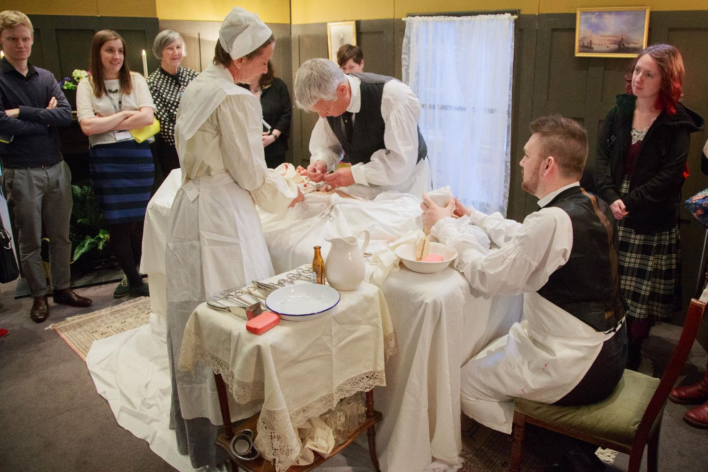
FUNDING OUR FUTURE!
Notes:
Introduction.
Introduce ourselves

Slide 2


RCN Libraries
The Library and Archive service in context:
libraries in London, Cardiff, Edinburgh and Belfast
54,000 print books
1,100 e-journals
30,000 e-books
www.rcn.org.uk/library @RCNLibraries
Edinburgh
Belfast
Cardiff
London
Notes:
TERESA
The Royal College of Nursing is a professional body and trade union for nurses and nursing staff and students. Nursing is the single largest profession in the UK, which is reflected in the more than 450,000 members we support
The RCN is now over 100 years old and the library service goes back to the early days of the organization - established in 1923
The library service has grown over the years and we’re a true UK wide offer with an extensive online library and physical libraries in London, Cardiff, Edinburgh and Belfast with our archive based in Edinburgh
We are funded from member subscriptions – We’re a ‘Royal College’ rather than a college – a community of professional practice, we do not run academic degree courses. So we do not receive government or academic funding. We are a not for profit sector

Slide 3
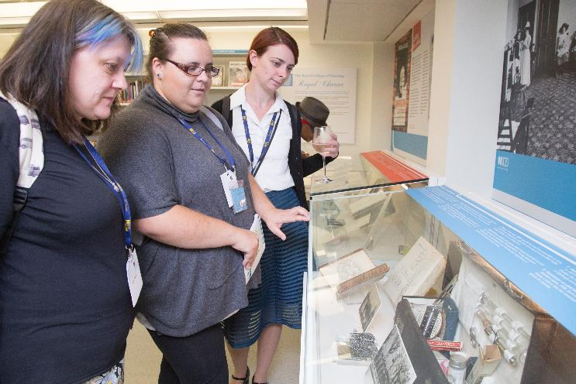
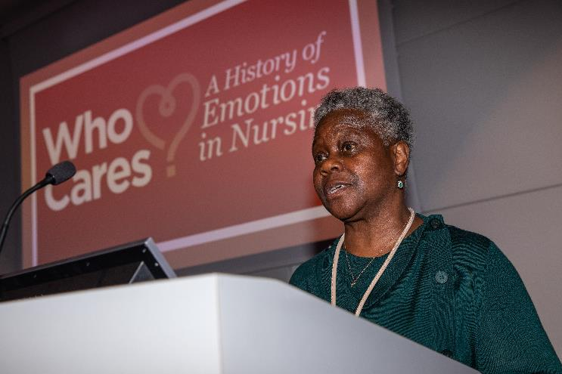
EXHIBITIONS
& EVENTS
RCN Libraries
Programme set up 2014
Now 2-3 exhibitions per year & 50 events
2020 – 2,609 event attendees
Notes:
TERESA
Our exhibition and events offer is much more recent
In 2013 a newly refurbished library space in our London HQ was opened. Its aim was to return to one of the original aims of the College, as the Cowdray Club – to be a welcoming space that encouraged members and those interested in the profession of nursing to meet.
A new public entrance to the library was created, removing the need for a reception, and the space was opened up with exhibition spaces created.
I led the creation of a new public engagement strategy – the members had asked for an exhibition space in the building consultation, and the organisation had said Yes! But nobody had put any funding around it.
The engagement strategy teased out who the RCN wanted to engage, a popular answer was ‘members staff and public’ – but when I pointed out this included Italian student coach trips that descend regularly on Oxford Street they realised we needed to refine this!
The core funding – that of 2x permanent staff was created as part of a Directorate restructure, from existing Library headcount. So there was some pain involved
Funding for the first exhibition came as part of the refurbishment – a significant 6 figure sum being donated by the RCN Foundation – which needed the public angle (as they had only recently been set up as a separate charity to the RCN).
Member engagement was a strong consideration, so ongoing funding for our x6monthly ‘temporary’ exhibitions (about £12 grand each) was secured from our Forum Governance Group. This funding is for member activity. So our exhibitions ‘have; to be co-curated by the Library & Archive Service and the History of Nursing Forum, and/or another specialist forum. The vision was to be a showcase for members and for the public to find out more about nursing and its story.
Although ‘forced’ to work with members, rather than have a budget line within our team. It has led us to build stronger relationships with our core audience, has given us access to the most amazing experts, and our forums and co-curators have brought their own audiences with them.

Slide 4
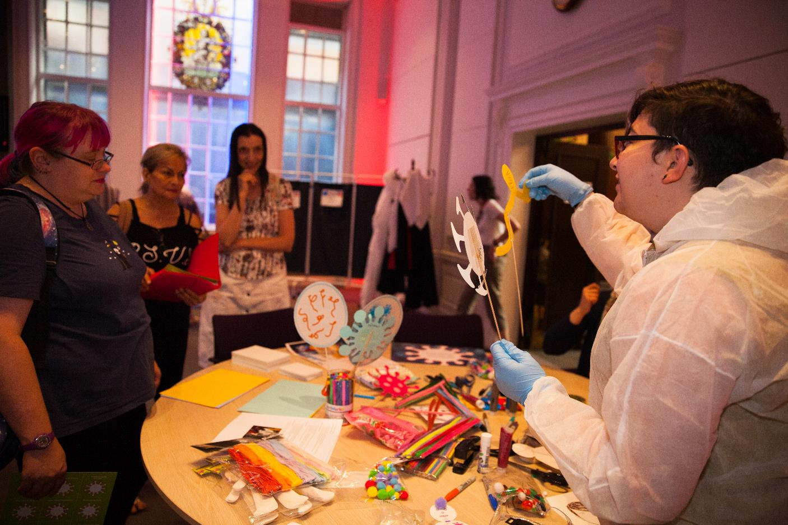
1: AUDIENCES
Notes:
TERESA
I want you to picture your audience, just like this. Always think about your audience first, not the funder
There are 700,000 registered nurses in the UK, and many more nursing assistants and health care support workers. We have to segment this for our projects.
If we focus on the audiences we want to reach we find effective funding If we focus on the money we may not reach OUR target audience – we will reach the one that is most important to our funder – and unless you are very lucky, this may not work.

Slide 5
1: AUDIENCES
Who is your audience?
  Existing audience / new or desired audience
Match audience with funder
  All will have different expectations
  General public means different things!
3. How will you engage them?
  Tailor your plans to the audience
  Consider outcomes – what do you want them to get out of this?
DON’T FOLLOW THE MONEY!
Notes:
TERESA
Break it down
Who is your audience -– if you follow your audience they often lead you to the appropriate funder
Match your audience with your funder - Funders will want to shape your project, and may come with existing networks/audiences
How will you engage your audiences, how will you reach them – what are your priority outcomes?
Don’t follow the money – you will not create sustainable and repeat audiences – you won’t create lasting relationships

Slide 6
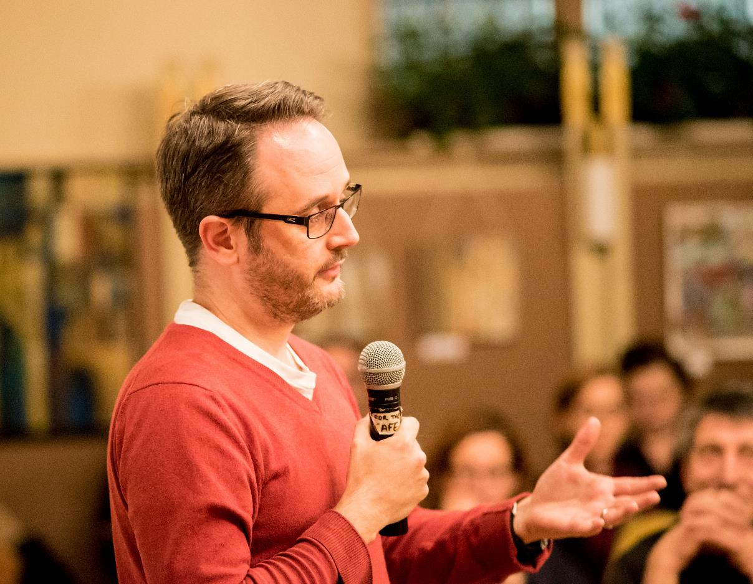
2: ONE-OFF PROJECTS
Notes:
SARAH

Slide 7
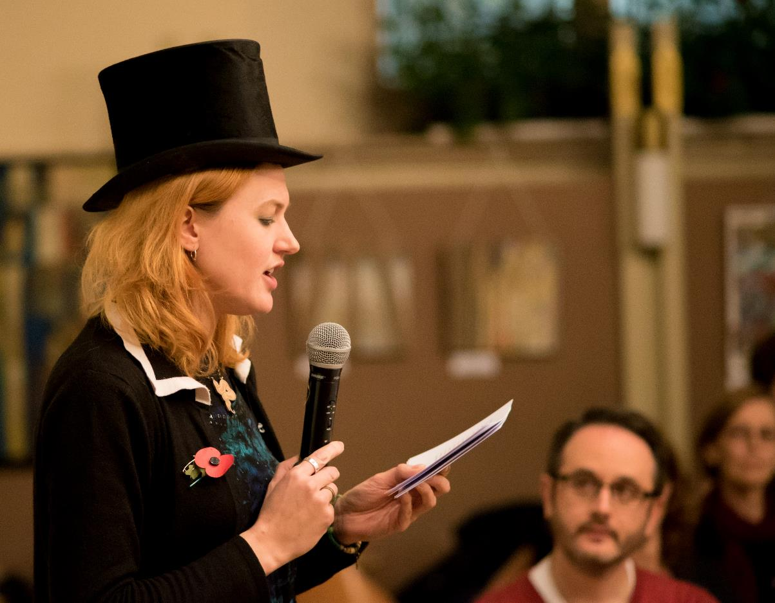
NURSING SHOWOFF
ESRC funded project (small grant)
What we did
Benefits of funding
  Manage in existing staffing
  Bring experienced people on board
  Try new things
Challenges
Notes:
SARAH
Nursing Showoff, ESRC Social Science Festival 2016, up to £1K. Look out for regular calls for similar activities from funders. Other examples: British Science Week or Being Human Festival of Arts & Humanities.
Small, one off event giving nurses and researchers a chance to “perform” their work to a public audience.
Had to specify audience to funders and how we would reach them. We stated local residents in Cambridge with an interest in health and cultural activities. Funder wanted to reach new audiences to emphasise value of social science – we pointed out that many people think of nursing as being part of medicine, and don’t realise that most nursing research falls within the social sciences.
It was a small project, so we managed it with our existing staffing. However, the funding allowed us to buy in freelance expertise, which was essential to success.
The funding gave us the chance to try new things, which we then repeated in other contexts – e.g RCN Congress. Right now, you might want to use small project funding to try out new methods of virtual engagement. It doesn’t have to work perfectly! Specify importance of development to funder
Issues – in a pub! Struggled to find suitable venue. Also difficult to manage promotion in Cambridge when none of the team were based there, so numbers were lower than we had hoped (c. 30 attendees). However, we learnt a lot about what worked and didn’t work to help us repeat the activity.

Slide 8
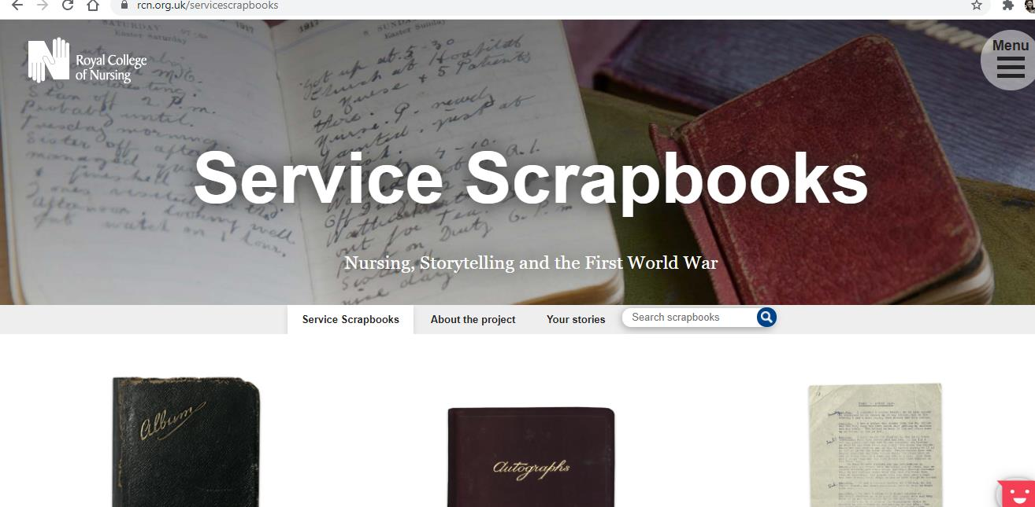
3: LONG-TERM PROJECTS
Notes:
SARAH

Slide 9
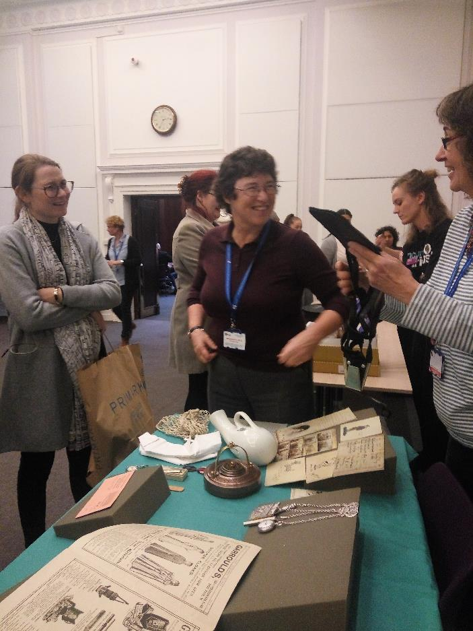
SERVICE SCRAPBOOKS
National Lottery Heritage Fund
What we did
Benefits of funding
  Necessary work
  Increased staff capacity
  Volunteers
  Evaluation
Notes:
SARAH
What we did – conserve, digitise, interpret scrapbooks. Writer in residence. With £60K funding
Audiences – worked with funder to develop this, the nursing audience was really valuable to them. Importance of involvement of nurse volunteers. Also, more development – reaching new audiences. We held 3 workshops with our creative writer, one for nurses, one for those with an interest in family history and one for schoolchildren (a completely new audience for us!).
Benefits – conservation/digitisation important for collection
Capacity/staff (graduate trainee)
Volunteers – we had thought we might need to involve public as volunteers, but actually HLF were very keen on us involving nurses. Talk to funder – the audience you think they want is not necessarily what they do! Ongoing input (expert volunteers)
Evaluation – budget for this!

Slide 10
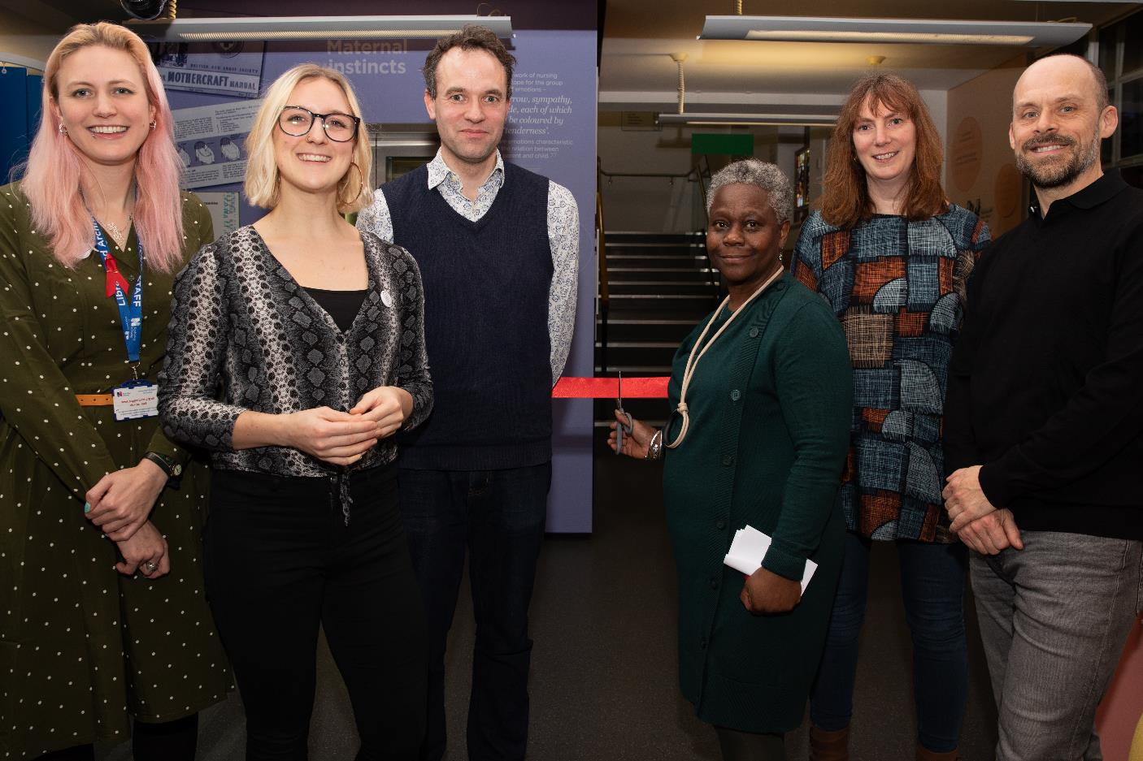
4: EXTERNAL PARTNERSHIPS
Notes:
SARAH

Slide 11
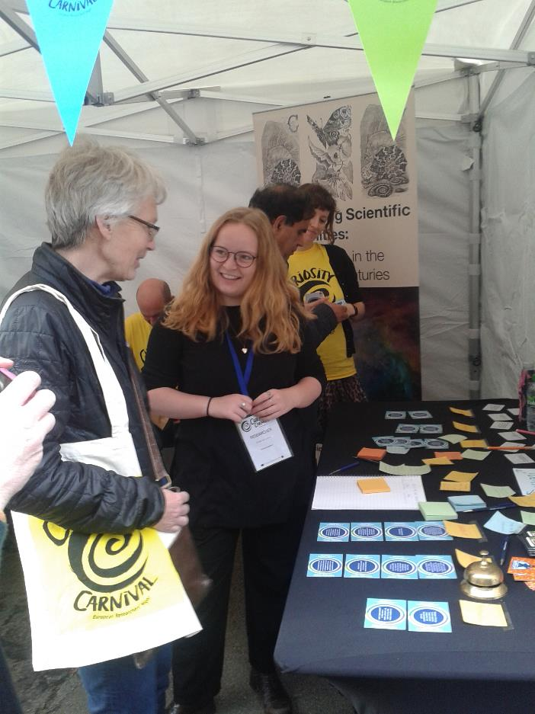
UNIVERSITY PARTNERSHIPS
Finding a partner
Setting the boundaries
Benefits for you
Benefits for them
Notes:
SARAH
Partnerships – external. Give example of QMUL total of £1.6 million, also Oxford and Roehampton £570K
QM example, funding already there and we developed partnership from it. Oxford we applied jointly. £33K
Individual relationships/finding the right person/networking
Public engagement/impact – setting the boundaries, co-write/co-design the bid (or have a clear written agreement who’s doing what)
Benefits for you: Access to funding, expertise, staffing support
Benefits for them: Access to new audiences, impact for REF, knowledge on public engagement etc

Slide 12
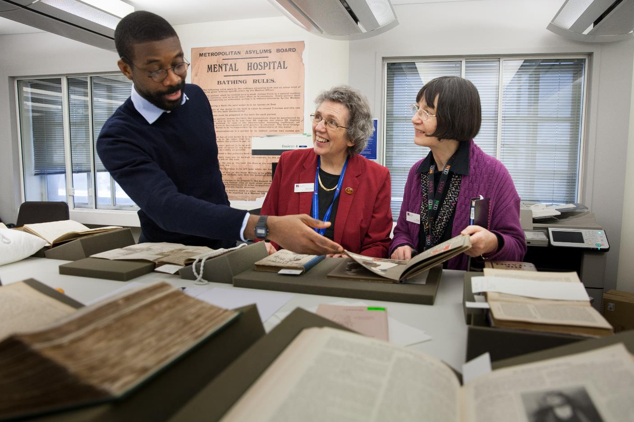
5: INTERNAL PARTNERSHIPS
Notes:
TERESA
We have 800 staff and 450,000 members.
We are led by our member Council and strategic groups as well as by our Executive Team. These are people who are active in nursing, are experts in nursing and want to share their professional knowledge.
So we have speakers, and audiences, and friends, and families, and colleagues (doctors, surgeons, managers, patients) who have a potential interest in our exhibitions and events.
We segment our audiences – using as a starting point our RCN History of Nursing Forum, for any member who is interested in this topic – over 2,000 of them now. In matching them up to other forums we have created looking back/looking forward exhibitions and events. Mental Health, Defence Nursing, Women’s Health, Diversity, Older People and coming later in 2020 Learning Disability Nursing. Our experts fearlessly take us on journeys more complex and challenging, covering topics that I would feel afraid to do in an exhibition on my own. Death. Discrimination. Dementia. FGM. Vaccination. History creates a safe space in which we can explore the past, but also recognise today’s issues.

Slide 13
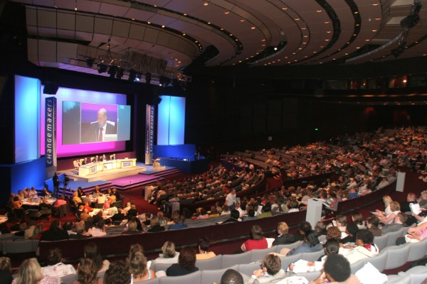
INTERNAL PARTNERSHIPS
Congress Digitisation Project
Identifying budget streams
Audiences
The art of persuasion!
Notes:
TERESA
Those members who sit at ‘top table’ in Council have frequently used our library services for years. It’s a very unusual situation for a service! So we have lots of advocates in the strategic groups that make final funding decisions
2 years ago an internal funding stream was announced around a particular theme. We popped in a cheeky project to Digitise our Congress recordings, funding of £35K. From 1968 members have met annually for 3 days to debate key issues and agree the core work of the RCN in the coming year. Like other active trade union events these are big – with around 5,000 members attending.
The recordings needed to be digitised and transcriptions created, and then existing staff could move them to our Digital Archive. Although the bid was rejected in that funding stream, it was seen as core work. So the Chair of Congress and our Chief Executive identified another pot of money and agreed the project. 2 years later our Congress was cancelled due to COVID, but in its place we launched our online Congress Archive last June. It was very emotional.
Lesson – Identify projects you want to do; Write a brief project plan and cost them – however roughly; Be cheeky! Look for money and ask! The worst they can do is say no. Take the skills from external applications and apply internally (persuasion, audiences, identifying budget streams)

Slide 14
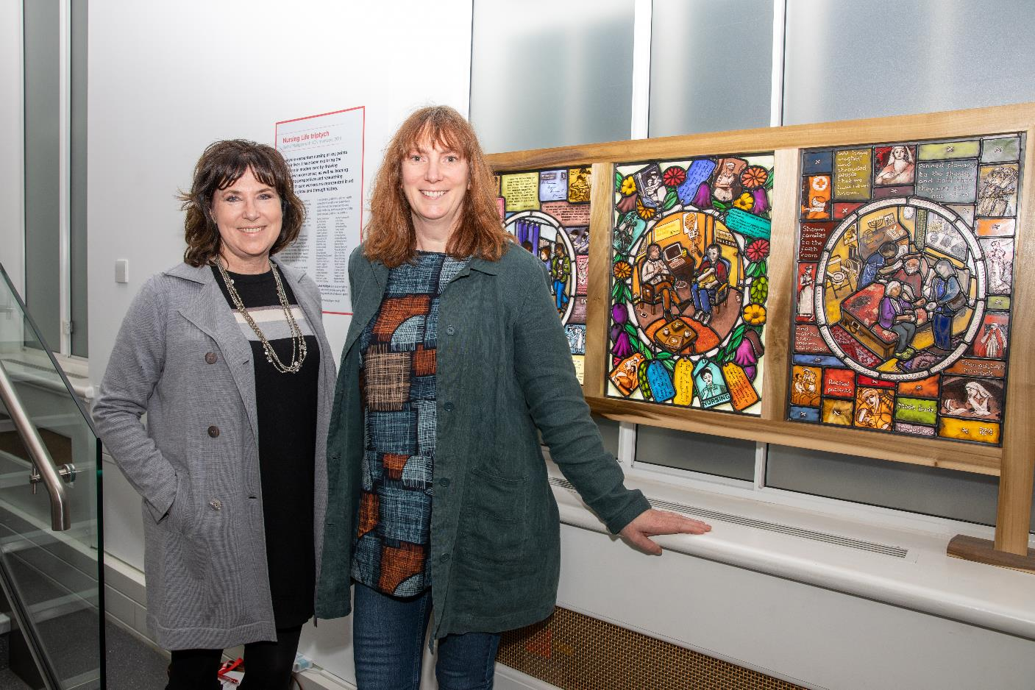
6: CONCLUSION
Notes:
TERESA
Plan your work as a team
Prioritise the work – what do you have capacity for
Bid for additional capacity – make sure you cost in staffing/freelance support where needed
Develop long-term relationships with partners – can lead to new opportunities. Lots of time & energy to put together a grant, but may not be wasted if you don’t get it, e.g. we didn’t get funding from Arts Council for stained glass project but able to go ahead via partnership with QMUL (we had already done all the scoping and planning work, so easy to approach partners)
Be prepared to say no

Slide 15
Notes:
Thanks for listening and do keep in touch

