Slide 1
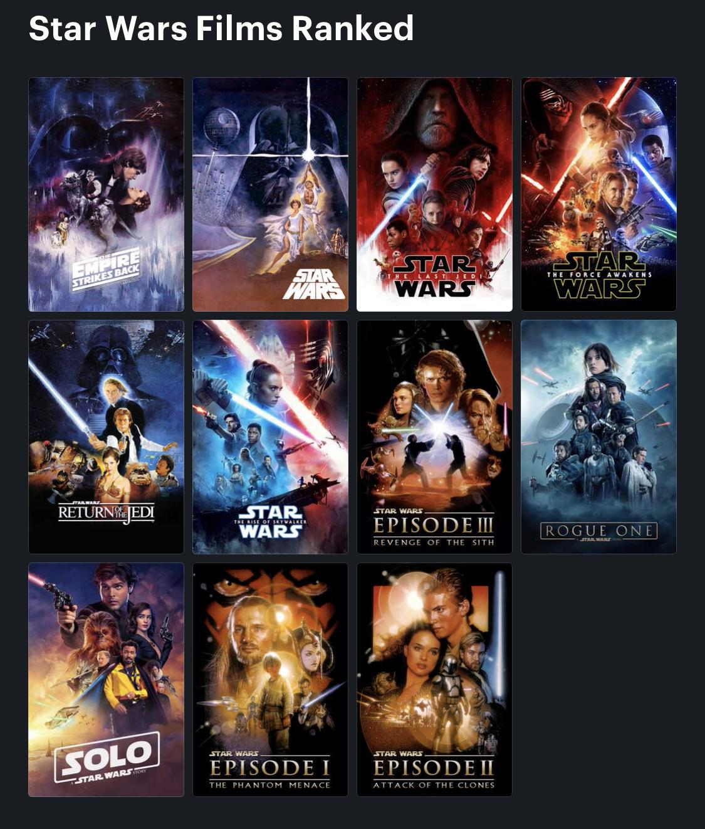
M25 Consortium of Academic Libraries
The Future of Libraries –
what can we learn from Star Wars?
Professor Shan Wareing
Deputy Vice Chancellor
University of Northampton

Slide 2
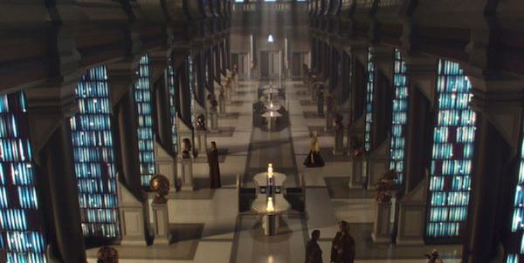
"If an item does not appear in our records, it does not exist."

Slide 3
A library contains multiple worlds, and as such when trying to replicate or transpose its meaning and function into a digital space, it’s almost functioning as a hypertext – both a consistently rewriteable, iterative thing, and a link to another world, if you like. This provides us the opportunity to reinvent and reconsider how learners interact with the space …
https://www.jisc.ac.uk/blog/rewriting-the-library-in-digital-space-23-feb-2021
David Parkes
Director of library and learning services, De Montfort University

Slide 4
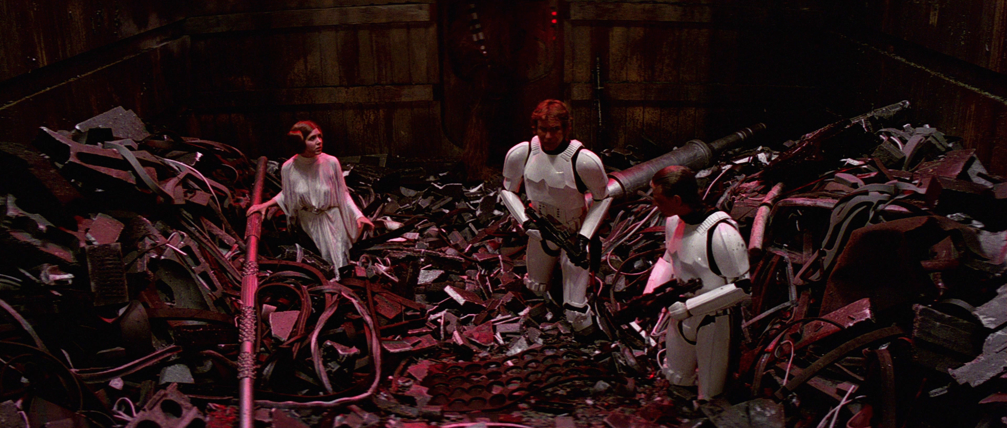

Slide 5
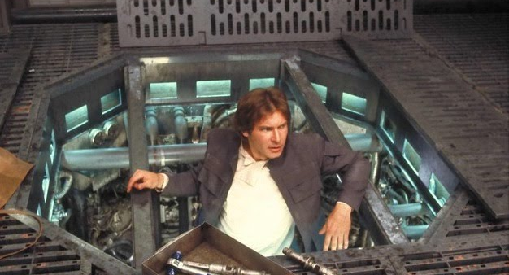

Slide 6
About me
Why Star Wars
Themes
Education and quests
Equality, Diversity and inclusion
Tech
Communications
Where did Star Wars get it wrong?
Libraries
AI and big data
What are the big questions for academic libraries in the future?
What will we spend our money on?
Where will digitisation take libraries?
What will entry level roles look like?
Who will control curricula?
Why will people come on campus?
How social will social learning spaces be?
For Universities?
How will university libraries support the next version of education?
How will university libraries rise to the UN Sustainable Development Goals?
How do libraries ensure the voices of their staff are heard and shape strategy at the right level in the university?
Who has access?
What will the goals of higher education be?

Slide 7
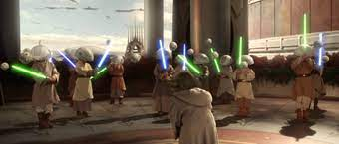
The Jedi Training Academy

Slide 8
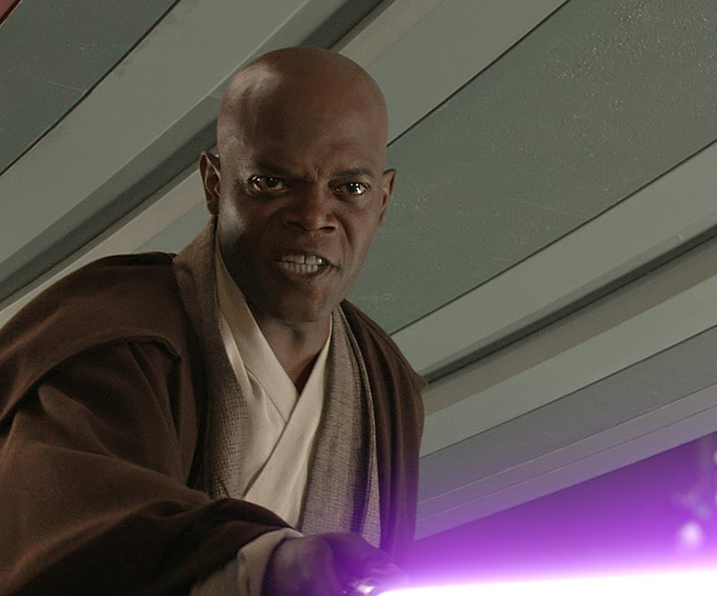
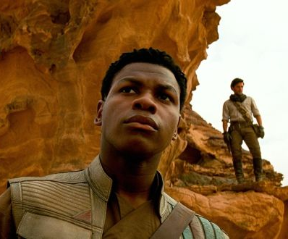
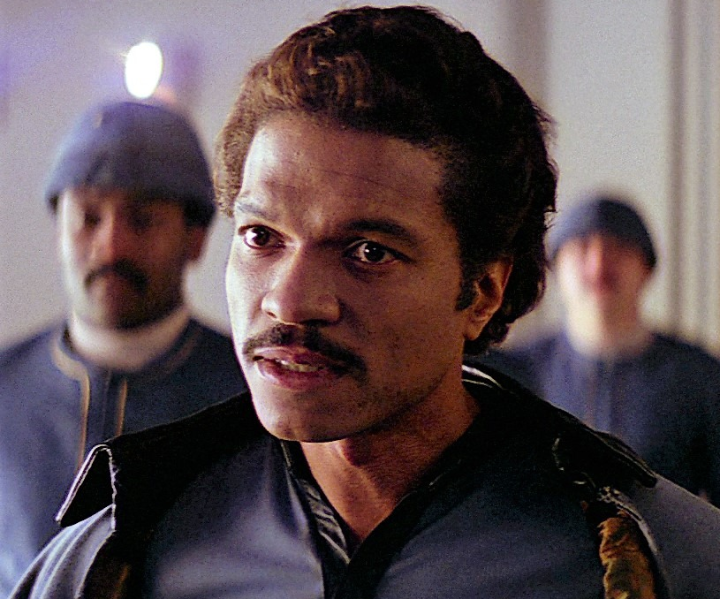

Slide 9
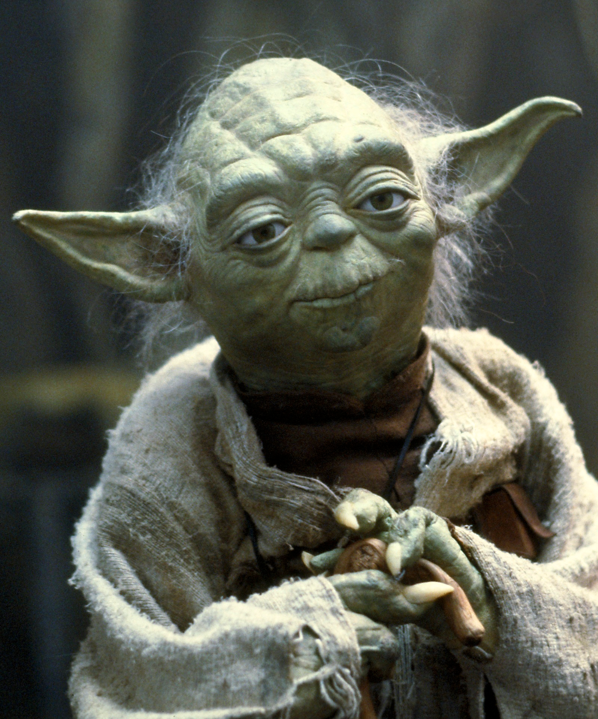
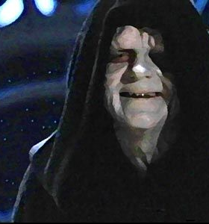
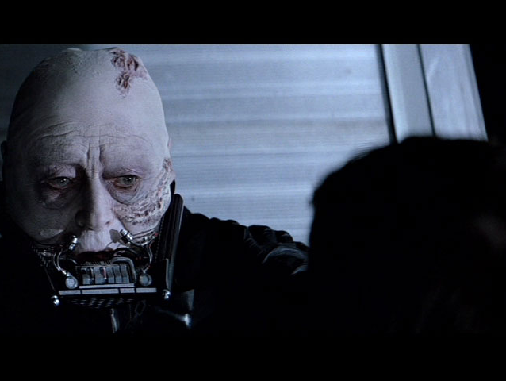

Slide 11
43%
17%

Slide 13
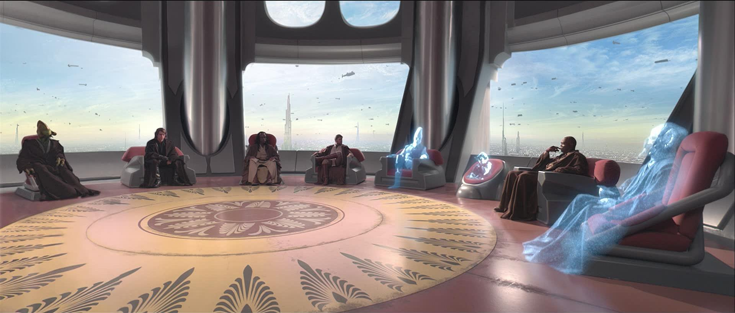

Slide 14
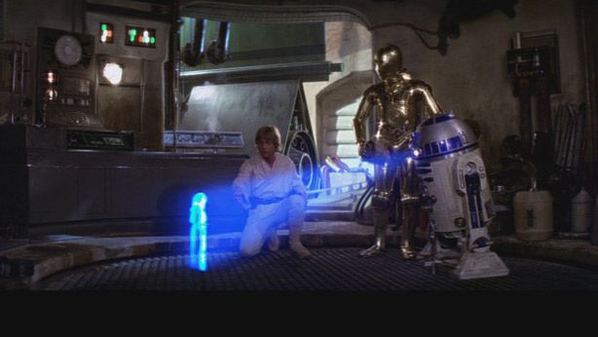

Slide 15
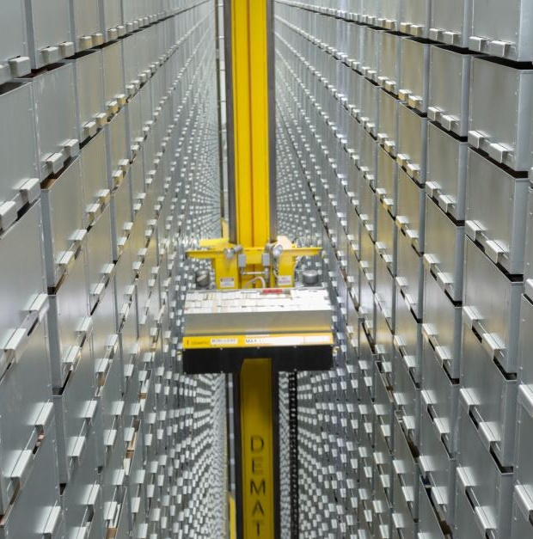

Slide 16
About me
Why Star Wars
Themes
Education and quests
Equality, Diversity and inclusion
Tech
Communications
Where did Star Wars get it wrong?
Libraries
AI and big data
What are the big questions for academic libraries in the future?
What will we spend our money on?
Where will digitisation take libraries?
What will entry level roles look like?
Who will control curricula?
Why will people come on campus?
How social will social learning spaces be?
For Universities?
How will university libraries support the next version of education?
How will university libraries rise to the UN Sustainable Development Goals?
How do libraries ensure the voices of their staff are heard and shape strategy at the right level in the university?
Who has access?
What will the goals of higher education be?

