Slide 1
Libraries:
the most truly democratic space?
Sara Burnett and Elizabeth Malone
Information Specialist Head of Student Services / formerly Co-Director Library & Learning Services
M25 Libraries Conference 30 March 2021
Notes:
Introductions – EM / SB
Welcome to our session today where we want to offer up a possible future of libraries viewing them as a truly democratic space.
Our presentation is based on a case study of our new library at Kingston University, the Town House, where we have endeavoured to deliver on its vision whilst being impact by the pandemic! That alone is enough to be wondering what the future academic library might now look like!

Slide 2
About Kingston
13,105 home/European students
3,680 overseas students from more than 140 countries.
Nearly half our students come from within a 10-mile radius of Kingston
KU Cares: bursaries and support for care leavers, estranged students, young adult carers and sanctuary scholars
One of the town's largest employers
Notes:
First a brief bit of background for those of you who don’t know Kingston University.
The university has just over 13,000 Home/EU students and over 3.500 international students.
Most importantly they originate from more than 140 countries. Equally about half live locally – although being local doesn’t always mean easy travel as you’ll all recognise and many of our students are therefore commuters.
We are diverse not just in terms of culture and ethnicity but also in terms of socio-economic backgrounds and we have an exceptionally successful programme called KU Cares bringing care leavers, estranged students, young carers and sanctuary scholars into higher education.
We are also one of the town’s largest employers.

Slide 3
KU strategy …
At Kingston University, we are passionate about enhancing our students' life chances by helping them make the most of their learning opportunity and equipping them with the skills and knowledge needed in the 21st Century's demanding workplace.
Notes:
KU22 is our current strategic plan.
And this is our key strategic driver – to enhance students’ life chances by helping them make the most of their learning opportunities and equipping them for the workplace.
Providing high quality study space is part of delivering this strategy.

Slide 4
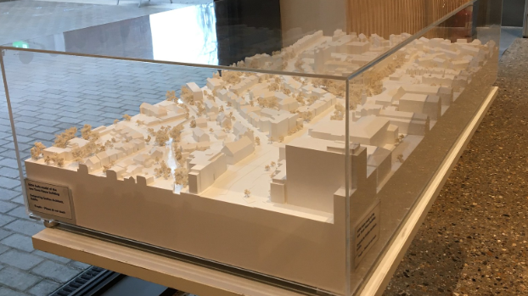
The brief …
“We were inspired by the progressive educational vision presented to us in this brief, the ‘open door’ policy, the wish to connect with the community and the town, the rich interactive potential of the various uses, the wish to make an open welcoming supportive environment for students and visitors.”
https://www.graftonarchitects.ie/Town-House-Kingston-University-London
Notes:
Which brings us to the brief for our new building.
When the project began, what the university lacked was a heart on its main, most visible campus, Penrhyn Road, which leads into the centre of Kingston.
Not only were the university buildings unprepossessing but they were dominated by the 1930s wedding cake affair of Surrey County Hall opposite which was frequently mistaken for the university.
This picture’s not great but our architectural model of the proposed building showed how it would be embedded within the town itself – this open door policy and connectivity to the community was a key element of the vision for this project.
The existing library on this campus was cramped, made up of an assortment of about six different buildings from different eras and tucked away off the main corridor. The only way to find the library was to know it was already there. Not very democratic to have a space that only a small number of people can find.
So when the university chose to commission a new, eye catching building with the library as a central component, we were overjoyed. We followed the process of RIBA Architectural competition with an eager eye and were intrigued to see the final, winning design submitted by Grafton Architects.

Slide 5
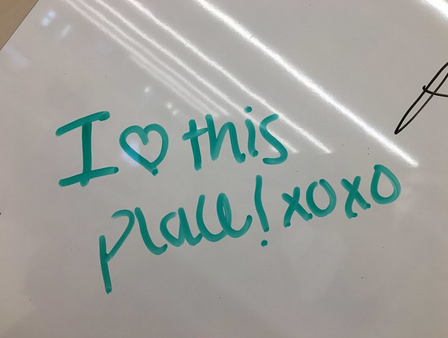
What it meant for the library …
An academic library with a difference;
Focal point of the campus;
Focal point for the town;
Library is a major element but we sit alongside:
Department of Dance
Performance space
Exhibition and event space
Archives and special collections
Cafes
Notes:
Whilst we welcomed the openness and community aspects, we knew that the proposed design challenged us. It meant a different model of an academic library.
Town House = the building. We don’t refer to it as the new ‘library’.
The library is a major element, but not the only one.
We would be collocated with Dance Studios and Performance spaces! We have to confess that it did take a while to adjust to this notion!
And we would have artwork displayed, not just in the foyer, but around the space. Would artwork and students mix?
Being such a focal point for the campus, would we be the main reception or would that function still exist elsewhere?
Did any of this mean we were getting the library of the future?? The project was 8 years in the making and we had lots of discussions with the lead architects, Yvonne Farrell and Shelley McNamara, who really wanted to understand how we thought the building would be used in the future.

Slide 6
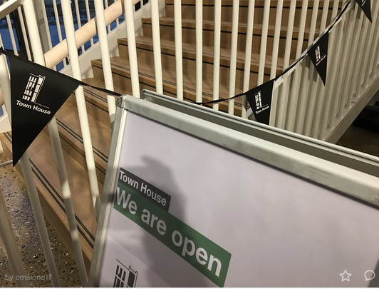
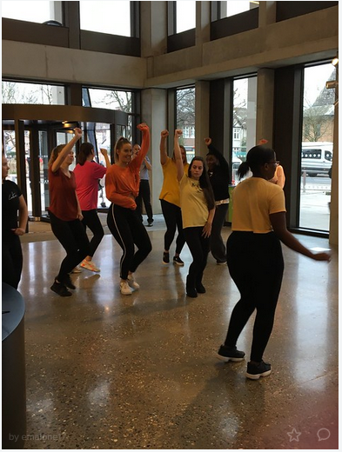
January 2020
Notes:
So, as I say, 8 years from start to finish BUT ..
In January 2020 we finally opened.
We’d had a few inevitable delays so it was quite a soft opening, lots of snagging work and adjusting to working within a new space.
But had we stepped into the future?

Slide 7
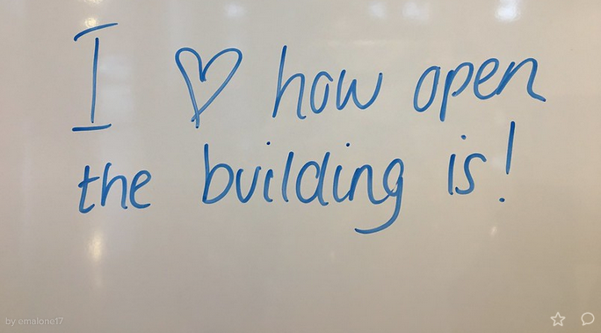
Jan/Feb 2020
Zone management
Doors (revolve/
access door)
Event impact (dance competition, art
installation)
Notes:
In those first few weeks, we felt not!
Most of the challenges we faced were those of the familiar kind – many of which we would welcome now! So Zones, doors, access control, events etc
Most were anticipated (noise and impact of variety of visitors to the space overall). Café above silent area likely to be an ongoing issue. Dance in the library – not a problem if restricted to the studios and dedicated spaces. The sound proofing is truly amazing!
The first few weeks were a complete whirlwind. Students found us in an instant with barely any publicity. We were soon packed out. And curious neighbours began to call in to see what had been behind the hoardings all this time.

Slide 8
Is this the library of the future?
“Welcoming ... porous... a warehouse of ideas.”
(Shelley McNamara, Grafton Architects, RIBA Gold Medal lecture 2020)
“The best place to lay your laptop?”
(Rowan Moore, The Guardian, 25 January 2020)
Notes:
Then the press arrived in force. Our architects were about to be awarded the highly prestigious RIBA Gold Medal and so the world’s architectural eyes were on us.
Quotes made us think more about what exactly it was that we had opened.
A warehouse of ideas – nice, quite like that. We like to think we store ideas but we had also developed areas for study where our students could create ideas – photo of benches?
But are we really just a place to lay your laptop? We felt far less comfortable with this.

Slide 9
Love nest!!
“The £50m lovenest: Kingston’s new library is a place to find books – and romance”
(Oliver Wainwright, The Guardian 28 January 2020)
Genuinely a photo Elizabeth took of one her first coffees in the new café!
Notes:
Then came the ‘Love nest’ review! Surely this isn’t the library of the future. In fairness, Oliver Wainwright then went on to make some really interesting points which were also mirrored by our student newspaper.
https://www.theguardian.com/artanddesign/2020/jan/28/kingston-university-town-house-library-review-oliver-wainwright-grafton-architects-riba-gold

Slide 10
The Guardian
The River
landings flowing into the library, which in turn flows into project rooms and dance spaces, with little of the compartmentalised sense that many academic buildings suffer from.
students flex their limbs on wall barres opposite pharmacologists deep in textbooks.
Above all, it feels social, designed to encourage encounters.
It is so open.
Another significant improvement is how bright it is inside.
The new group rooms are great when you have group projects.
The extended opening hours of the café upstairs is great. And the view is definitely a plus.
Notes:
The critics and students alike reading the building in the same way emphasised to us that the architects had met their brief but the quotes made us think, is this the library of the future?
Is it about openness? It is about encounters, social or academic? In providing this space, what are we contributing to the learning process other than just access to books, PCs and a decent enquiry service?
So lots and lots of questions to get us thinking – and at this point I will hand over to Sara.
https://riveronline.co.uk/8-things-i-love-with-the-new-town-house/ what the students love about TH – well isn’t this all surprisingly traditional? In fact one of the things the students loved best was the flag system we’d introduced to the book shelves making it easier to navigate!

Slide 11
Questions, questions, questions
Is porous good? What is the student experience?
Were the public coming through the doors and what did they think?
Were we only a place to lay your laptop and nothing more?
Were we really a lovenest?!
Was the building being used differently to the old library?
What did this mean for our services now and in the future?
Notes:
As Elizabeth says, all of this meant that that these questions were circling in our heads. One aim of the project, that was part of the brief, was to create a porous building, so we needed to try and get some answers from various users on what that meant to them, including the public, and also to determine whether the library space was being used differently.

Slide 12
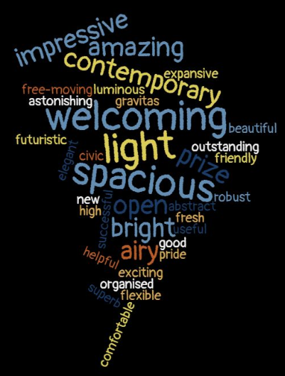
January 2020
Observations
Mapping
Whiteboards/
visitor book
Before/after perception sheets
Before
After
Notes:
It had always been our intention to carry out some post-occupation evaluation of the building and we now set about doing this.
We began by gathering our evidence. Initially this was whiteboard feedback and comments and a visitor book. Then we moved on to before and after perception sheets which we handed out to visitors, which was a very simple and useful way of gauging, in particular, their emotional response to the building.
Size and space were very clearly perceived as key features, both before and after. And it was gratifying that welcoming was the most frequent comment, once people had visited.

Slide 13
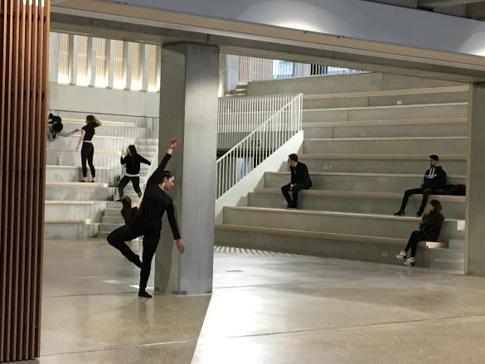
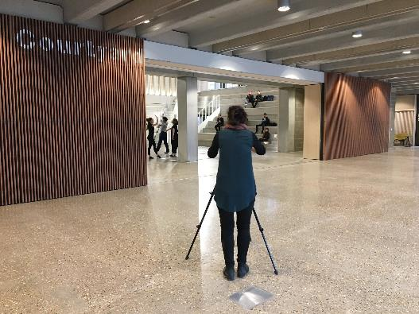
February 2020
Talking to the public
Interviewing them at events
Notes:
We also took advantage of different events that were taking place at this time. We had some visits by groups of architects but also a national Dance competition which enabled us to interview students from other universities and some of their parents too.
Going forward, this was planned to be a combined use flexible space. One very visible example being that, while not billed as a gallery (we have one) art has been (and is being) installed and this may act as a ‘shop window’ to passers by .
So, we really began to build up a picture of the public perceptions of the building to go alongside that of the student feedback.

Slide 14
March 2020
Openness
Approachable desks
High ‘touch’ services
Volume of visitors
Long opening hours
Future we did not plan for…
Notes:
Then we reached March and the openness which was such a positive was now transformed into a challenge. The points on this slide show some of our worries mid March (w/c 16th).
This was to be the library which we never had to close… with various entrances/doors/many without locks (!), and multiple ways to navigate the spaces made this a complicated business.
Can you fully close a building which includes teaching spaces (such as the dance studios)?
Our Help points were designed so as not to provide barriers emphasised by the positive feedback on a welcoming environment – how could this be switched to introduce barriers to ensure student/staff safety?
So, the Town House was locked on 23rd March … certainly not the future we had planned for, only open for 11 weeks!

Slide 15
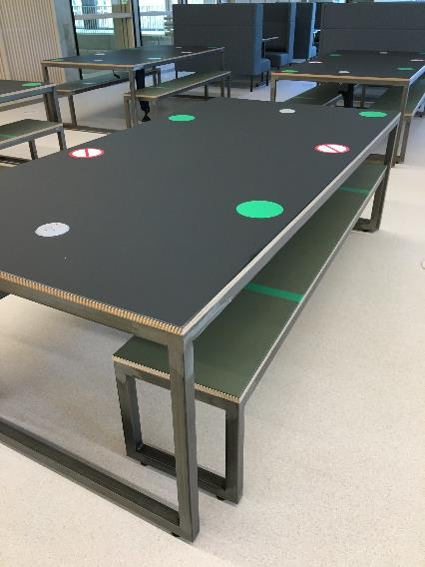
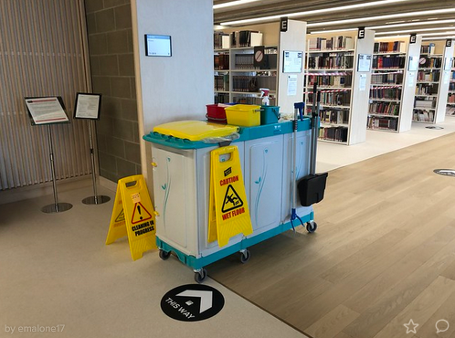
July 2020
Notes:
In July 2020 we returned to campus and get to open Town House for the 2nd time in a year!
We began with a booking system but soon decided that it was a rod for our own backs and that we weren’t doing students any favours.
Instead we went for the ‘count them in and count them out’ occupancy controller method. Whilst this is an additional staffing resource, many more resources were be required to run a booking system.
The advantage is that students are still able to choose where to study within the building and, in some ways, has enabled us to uphold the principles of the building in terms of a democratic space, though not so porous as originally envisioned and we were closed to external visitors and the general public.
I don’t think we have had the opportunity to fully reflect on the long term impact of these changes, in the context of this being a future facing library, but many of the required changes do feel rather opposed to the initial spirit of the place.

Slide 16
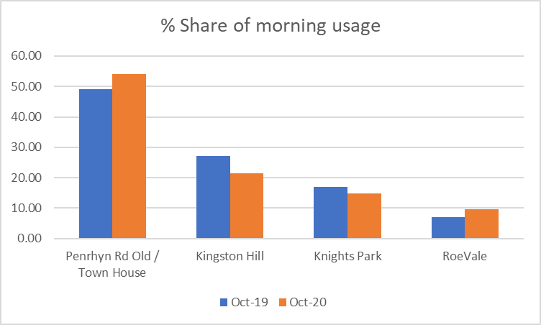
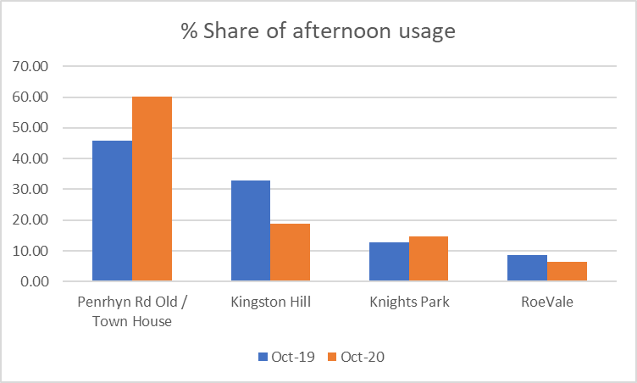
Back to the future
Notes:
In terms of assessing the use of the building following reopening for study space, it’s been back to basics with headcounts and what you can see is that there is a huge draw towards the Town House.
If 48% of library visits used to be made to the old Penrhyn Road library, we can now see that Town House now accounts for more like 50-60% of usage.
Yes, we know these figures aren’t comparable (Oct19 vs Oct20) but that’s Covid for you – we’re using what we can!

Slide 17
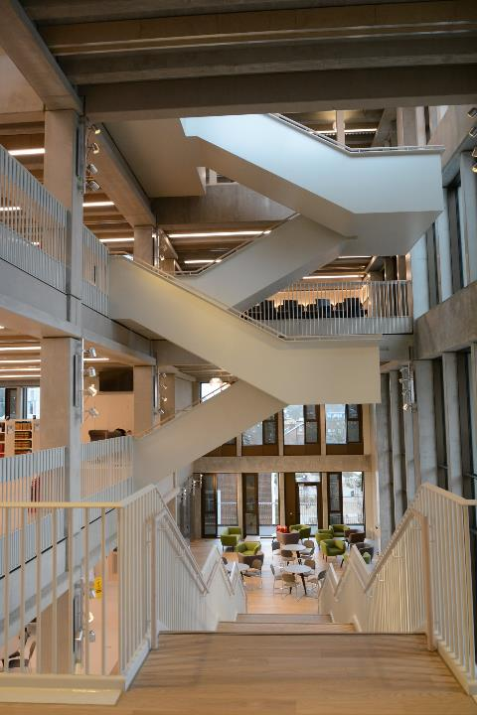
Popularity contest
“Quiet” floor the most popular on weekdays
“Social learning” most popular area at weekends
“Silent” floor has been the least popular since post-pandemic re-opening – but then all floors are single study space
Group study rooms remain popular for individual use
Silent pods – least popular but were most popular in old library!
PC spaces popular, especially where work can be laid out
Work benches the most successful choice of furniture
Notes:
Fortunately our head counts are carried out by zones which are arranged by floor, so as well as knowing whether each ‘zone’ ie. floor is busy or not busy, we can work out to an extent whether some types of furniture attract students
All usable study spaces are currently marked up for social distancing but students can still choose where to sit so we can still get an idea of their preference
However, significantly lower usage overall could well mean that much of this data is skewed or open to misinterpretation. For example, are students not making use of what was originally designated as silent simply because it is on the 4th floor and, at present, reduced numbers mean that noise levels in lower floors doesn’t impact on them. Lift capacity is significantly reduced, so perhaps the staircase is too much of a challenge!?
We also don’t know if students are using the library because they are on campus for scheduled activities (which would narrow the range of students by subject area) and it is the only space available, or due to lack of facilities at home.
This has given us a basic understanding of the building in its current iteration, but the journey that we thought we were on has changed.

Slide 18
Opportunities
Information Centres – one stop shop for all 1st line student enquiries – democratic approach
Open days – welcoming space for parents as well as applicants
Performance and the arts
Archives / public / exhibitions
Community use e.g. creative writing group for the homeless
Notes:
It was always intended that TH would host public events (lectures, performances etc), requiring organisation around ticketing, stewarding, green room and social spaces. While not new in public libraries, for academic it is.
Positives of interdisciplinary staff working relationships (security, reception, catering, technicians, librarians, student services, lecturers etc). Example of sound test, haze. Some of these were anticipated, others have been hastily developed. For example to close the building.
Whose building is it anyway?? At KU all space is university space. What are the implications of this? AUDE/Wilmot Dixon research piece.
Student perception of value (space, library, all of it?). At KU since TH opened, the ‘feel’ is that it is valued.
The mystery spaces, such as 5th floor corner room…

Slide 19
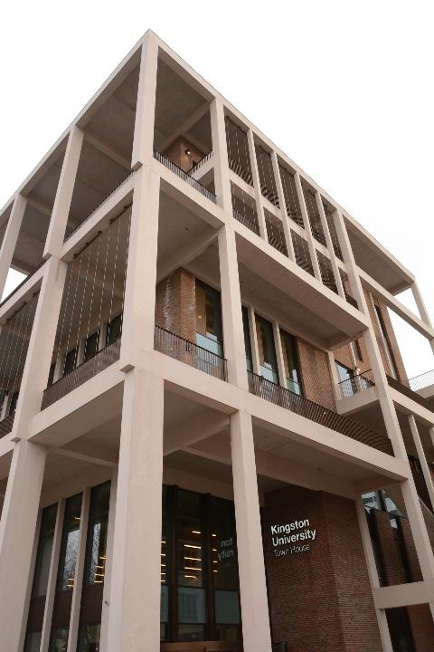
Where could it go?
“A grown-up climbing frame for students. A three-dimensional town square for the social life that will one day return. Generous and dignified.”
(Rowan Moore, The Guardian,
27 December 2020)
Notes:
I like this quote as it encapsulates a sense of exploration, as well as the civic experience being equal to that of the students.
Clearly there are now challenges now around managing student expectations. If we open services and/or access fully in Autumn 2021, our final year students at that stage will only have experienced the old PRD library for one TB. TH may no longer perceived as new?
We will continue with our plans to locate our ‘one stop shop’ helpdesks within our libraries, including within the Town House where we anticipate that staff will be answering enquiries from the general public as well as from students (once we allow them in again!).
Within the library, three project spaces were described as part of planning, but were never clearly defined, some physically as well as conceptually. However, there could be some potential for future use as on campus blended learning space for students. Long term changes in teaching may affect our provision, is the library now a place to learn on campus when you are in a virtual lecture?
It is also important to say that the new Archive space in Town House had always looked to provide new opportunities, especially in collaboration with the local borough – ironically enough, covid is providing new content for the archive!! Staff and student interest in the archives has remained high, so although the content has yet to move to its new home, it is already a much more visible service.
One big question still remains… will we ever have an official launch?

Slide 20
More seriously …
“learning spaces might be the next big thing to re-explore… we need to capture and work out what were the most productive spaces for our students during lockdown.“
(Rosie Jones, Digifest 2021,
9 March 2021)
Notes:
What has become very clear over the past year is that space, library or otherwise, is clearly valued as part of the wider student experience.
KU has been carrying out regular Pulse surveys during lockdown, one of which included a question on library use. A high percentage of students felt that they had been denied access to the library due to the pandemic and seemed to go hand in hand with the call for refunds that many of us are hearing across the sector. However, we all know that Librarians have maintained, and in fact enhanced, access to the virtual library throughout. This does demonstrate how strongly students still define the ‘library’ by its space. We clearly need to do much more work on the visibility of the virtual library before we change this perception.
The conversations that are now taking place regarding flexible spaces are replicating those that we have had among ourselves at KU, while the planning for TH was taking place. Have we inadvertently planned for this unplanned future? One 'absolute' was always that TH was not a teaching space (excepting the studios). Now teaching may continue to take place anywhere, we need to reconsider this. This seems to chime with themes coming out of recent conferences and wider sector discussions, highlighting the importance of space in a way we didn’t imagine a year ago. Elizabeth has referred to our contribution to the learning experience, often it can feel as if the relation between library buildings and learning has been implicit, but is becoming much more explicit.

Slide 21
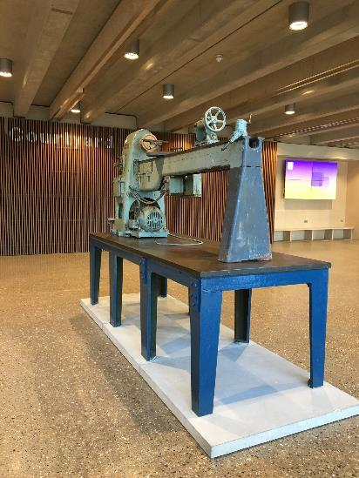
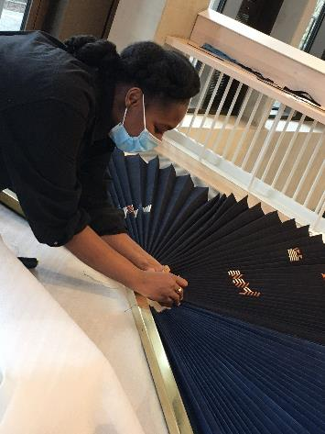
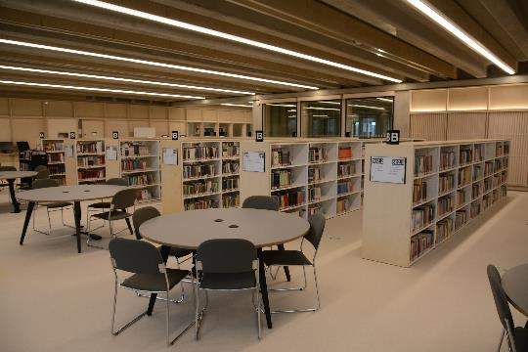
The Future?
“ …we have no doubt that students will continue to value the library as a physical space, characterised by this sense of collective academic endeavour as providing a supportive environment for learning or research, that’s held true throughout the last 30 years of digital change. But how we design and use our spaces may need .”
(Ann Rossiter, Digifest, 8 March 2021)o change.
Notes:
So where does that lead us with thinking about the future academic library? When we began the Town House project 9 years ago, we were asked what our future requirements would be. Would we need fixed PCs? Would we have DVD players still? What would be the ratio of books to study space? There are two things that we highlighted as key back then, which are still true today and they are:
Digital access
Flexibility
With those two things, our buildings can become whatever our students would like them to be. With the possible exception of a lovenest… ☺

Slide 22
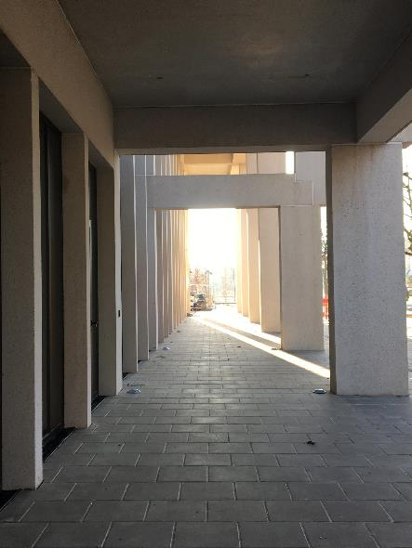
Thanks
To Nicky Ross and Josh Evan for number crunching for us!
Notes:
And with that, we’ just like to thank our colleagues Nicky and Josh for doing the number crunching for us for this presentation.
Let’s hope we are all beginning to see some light at the end of the tunnel!
Thank you for listening, any questions?

